Slide 1
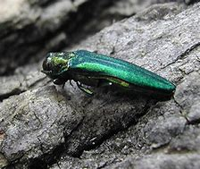
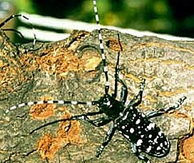
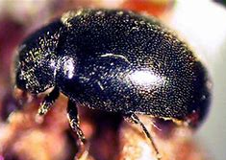
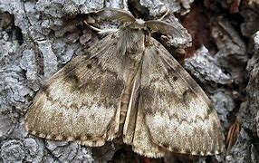
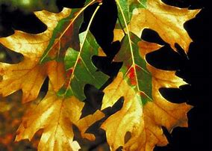
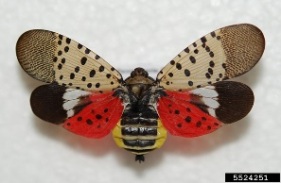
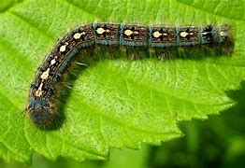

The European Gypsy Moth …..
Just another bad memory from 2020?
Eastern Ontario Model Forest Winter Woodlot Conference
February 3, 2021
Eric Boysen
NewLeaf Forest Services
Maberly, ON
Kemptville Winter Woodlot Conference Webinar - February 3, 2021

Slide 2
First, some context …
I’m not a gypsy moth expert, and don’t really want to be!
I’ll be providing you with a mix of science and personal observations from my own experience with the outbreak of 2020
I will discuss what I think will happen in 2021, and what management actions can be taken
Kemptville Winter Woodlot Conference Webinar - February 3, 2021

Slide 3
Now, about my forest
I live with my wife on 200 acres in glorious, year-round self-isolation in western Lanark County
My forest management objectives are to restore the health and diversity of the forest after a history of grazing, unsustainable logging, and past natural calamities
Kemptville Winter Woodlot Conference Webinar - February 3, 2021

Slide 4
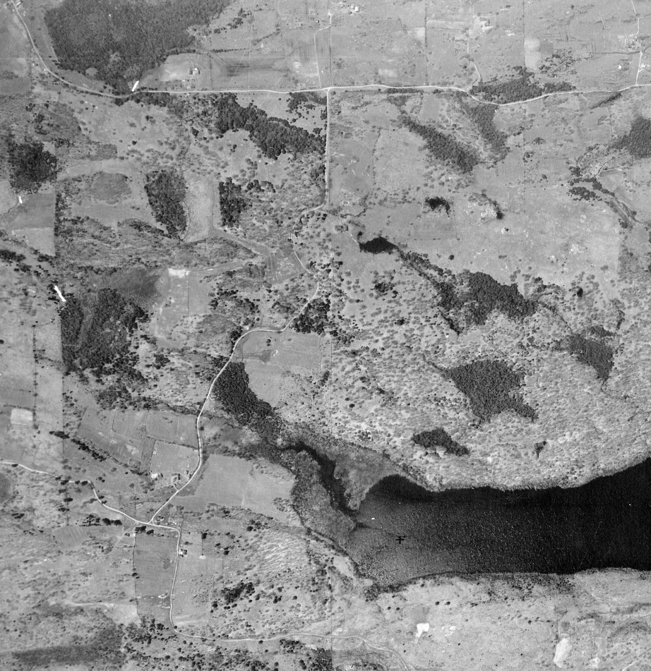
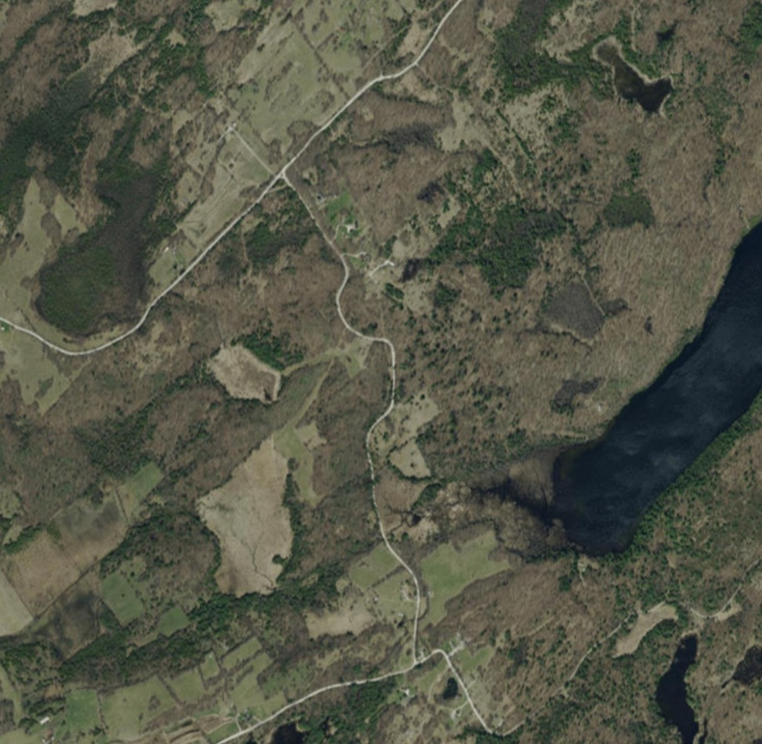
Fagan Lake, then and now
Archive photo, 1929
Current
Pastured Landscape
Forests in recovery phase

Slide 5
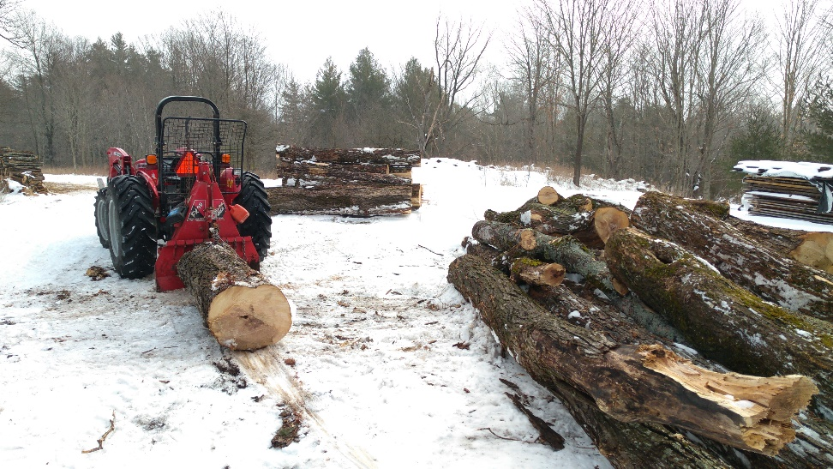
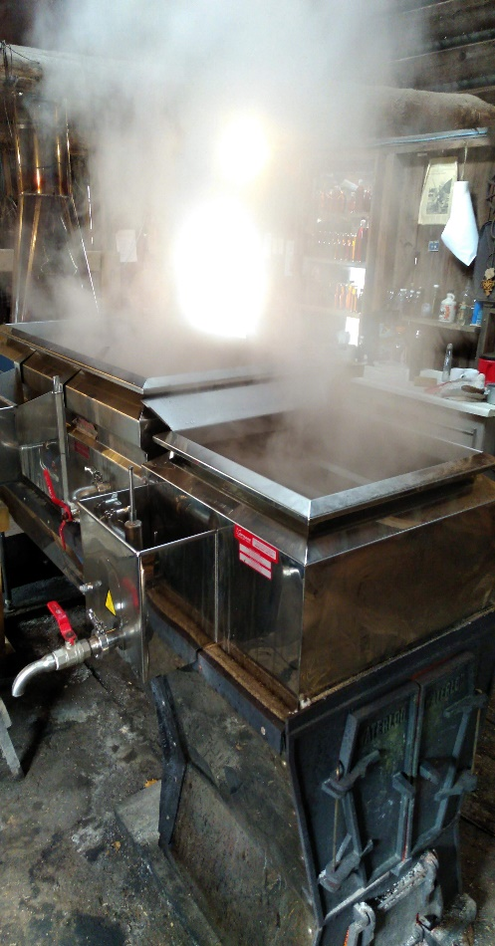
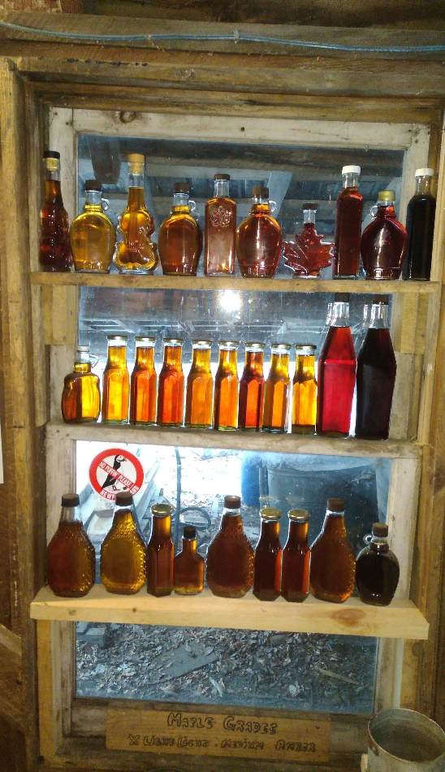
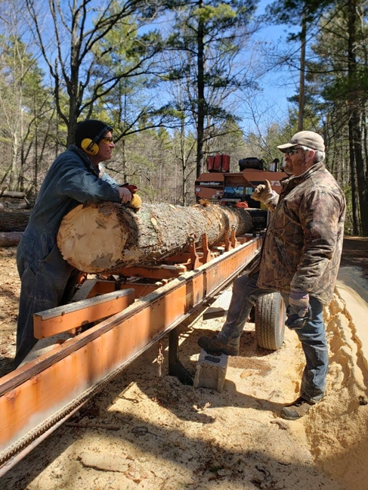
My forest management objectives
Wood products
Other products

Slide 6
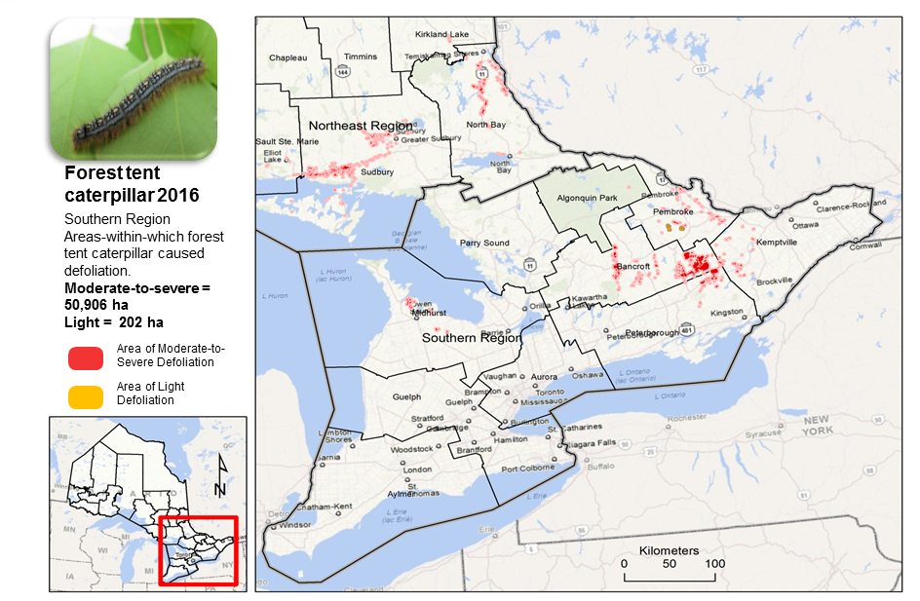
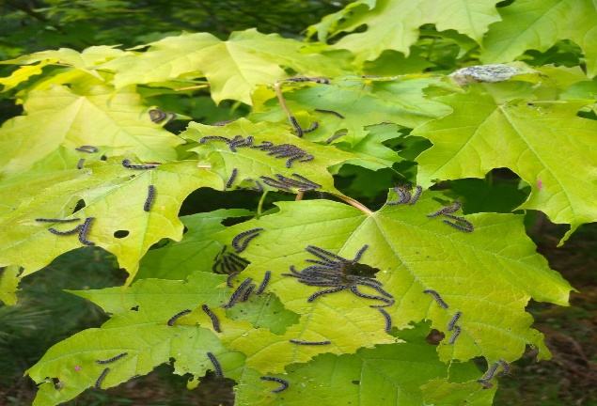
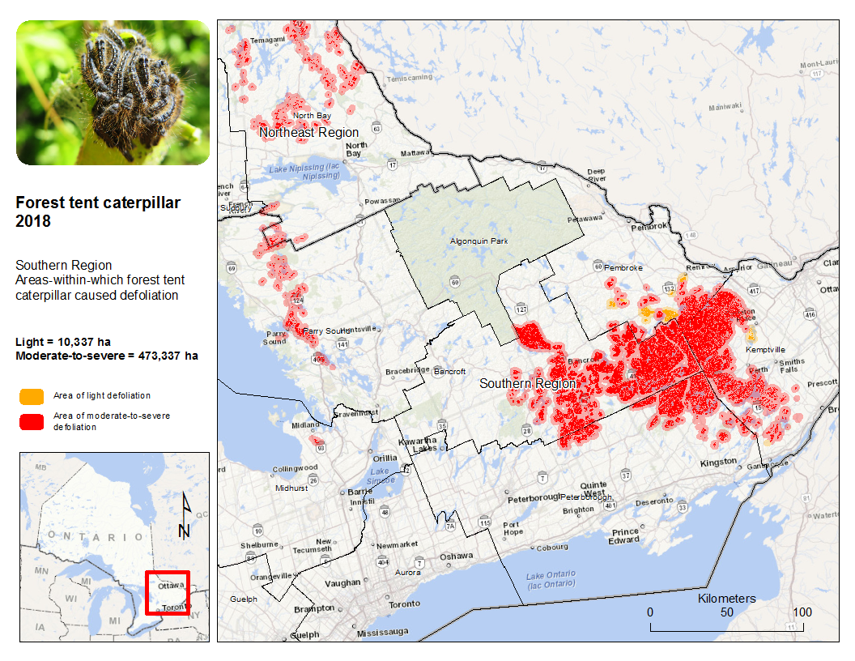
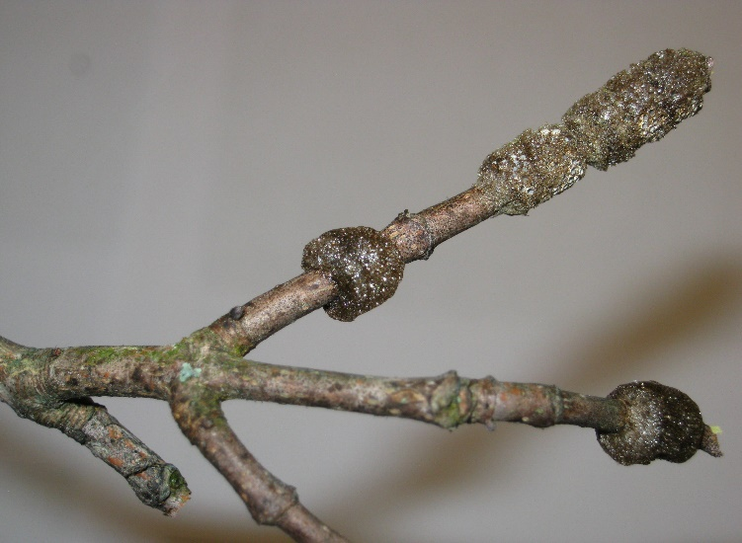
Lessons Learned from Forest Tent Caterpillar 2016 to 2019
6

Slide 7
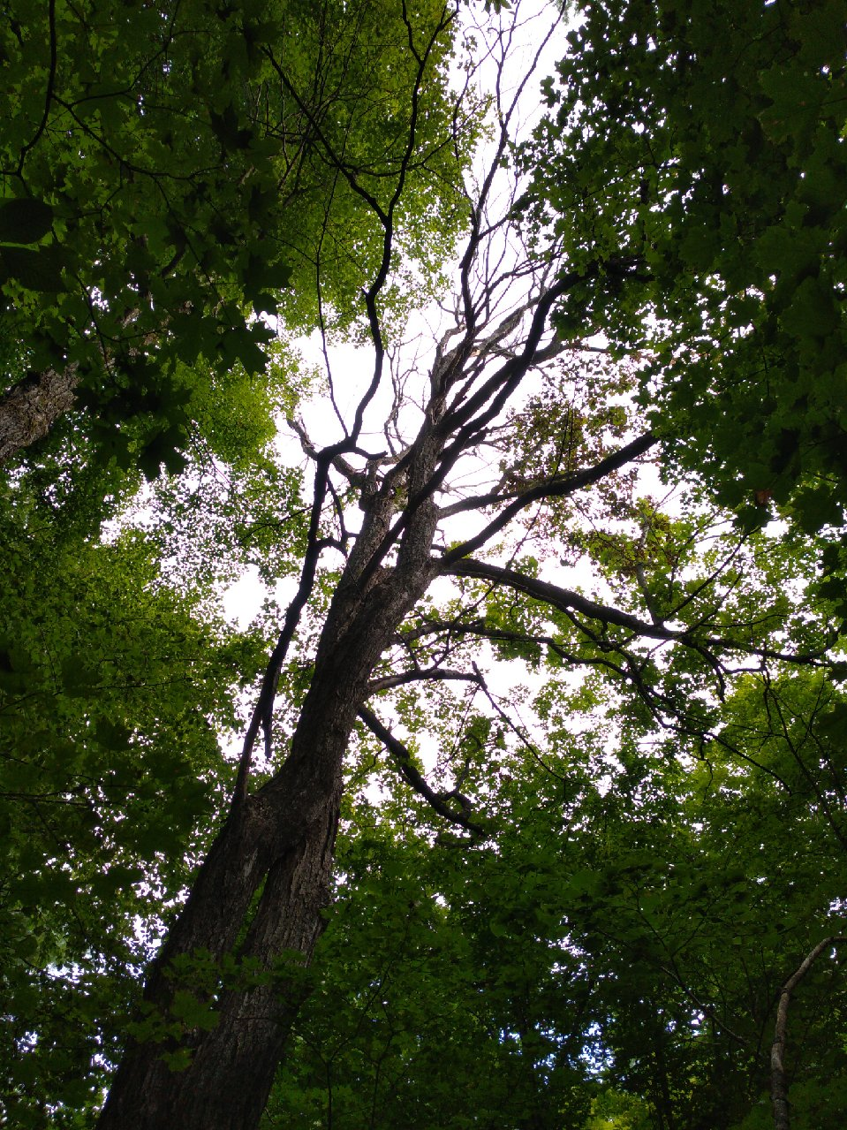
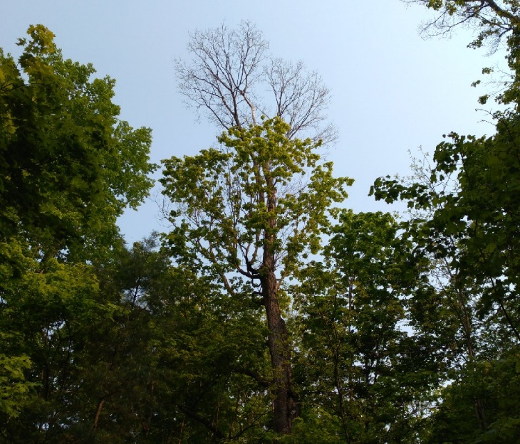
Personal observations
Three years of successive defoliation beginning in 2016
Combined with summer heat and droughts
Preferred tree species include sugar maple, oaks, poplars, cherry, basswood, ash
Did not affect soft maple, beech, yellow birch, ironwood, conifers
Most trees re-foliated, but some of the large 150+ year old maples struggled
Maple producers had some success controlling the outbreak using aerial spraying of BTK
FTC population collapsed in 2019 with the virus and fungus, combined with the Friendly Fly
The forest had 2019 off … or did it?
Gypsy moth population was beginning to build
7

Slide 8
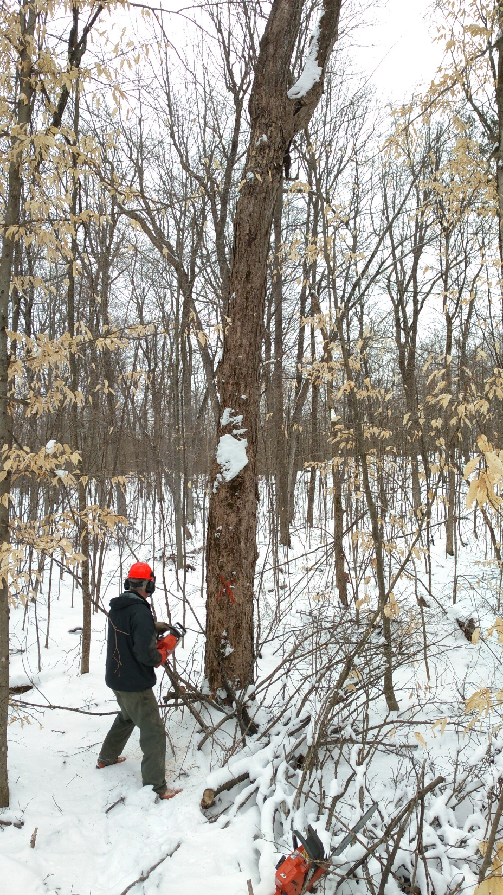
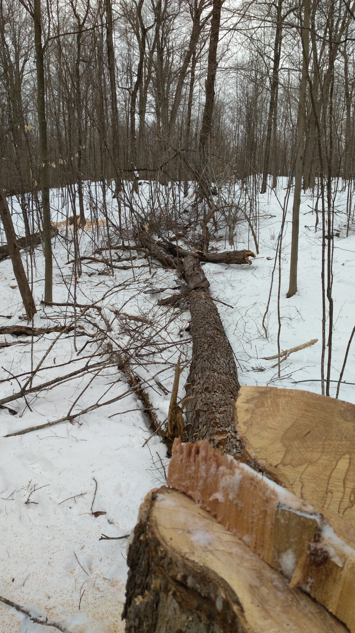
Final results of FTC
I lost between 15 and 20 of the mature / over-mature sugar maples – they just couldn’t handle it
These are now in the log and fuelwood pile, but some were left standing as wildlife trees
Will Gypsy moth cause the same problems?
8

Slide 9
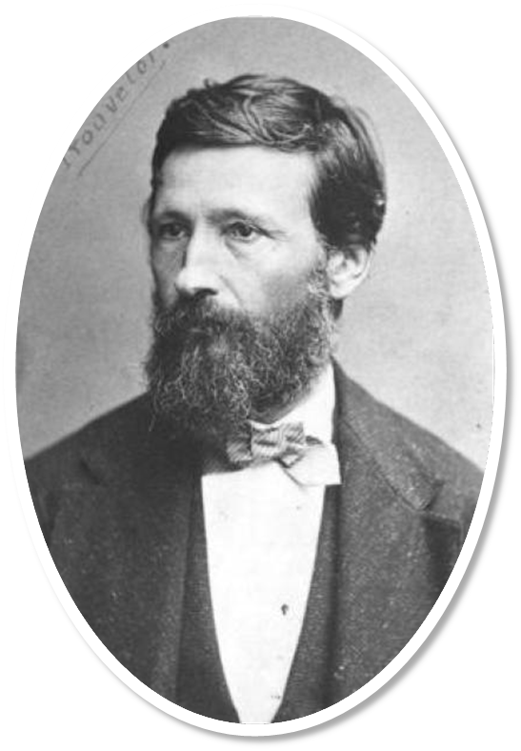
History of Gypsy Moth
Native to Europe and Asia
Professor L. Trouvelot introduced the Gypsy Moth from France in order to cross with a silk worm in hopes to develop a North American silk industry (bad idea and it didn’t work!)
Escaped from Massachusetts in 1869
Now established throughout eastern North America, and is considered to be one of the most significant defoliators of hardwood trees
Is a “regulated” pest by the CFIA
Highly mobile – can hitch hike to expand range
There are both the European and Asian gypsy moths in North America now

Slide 10
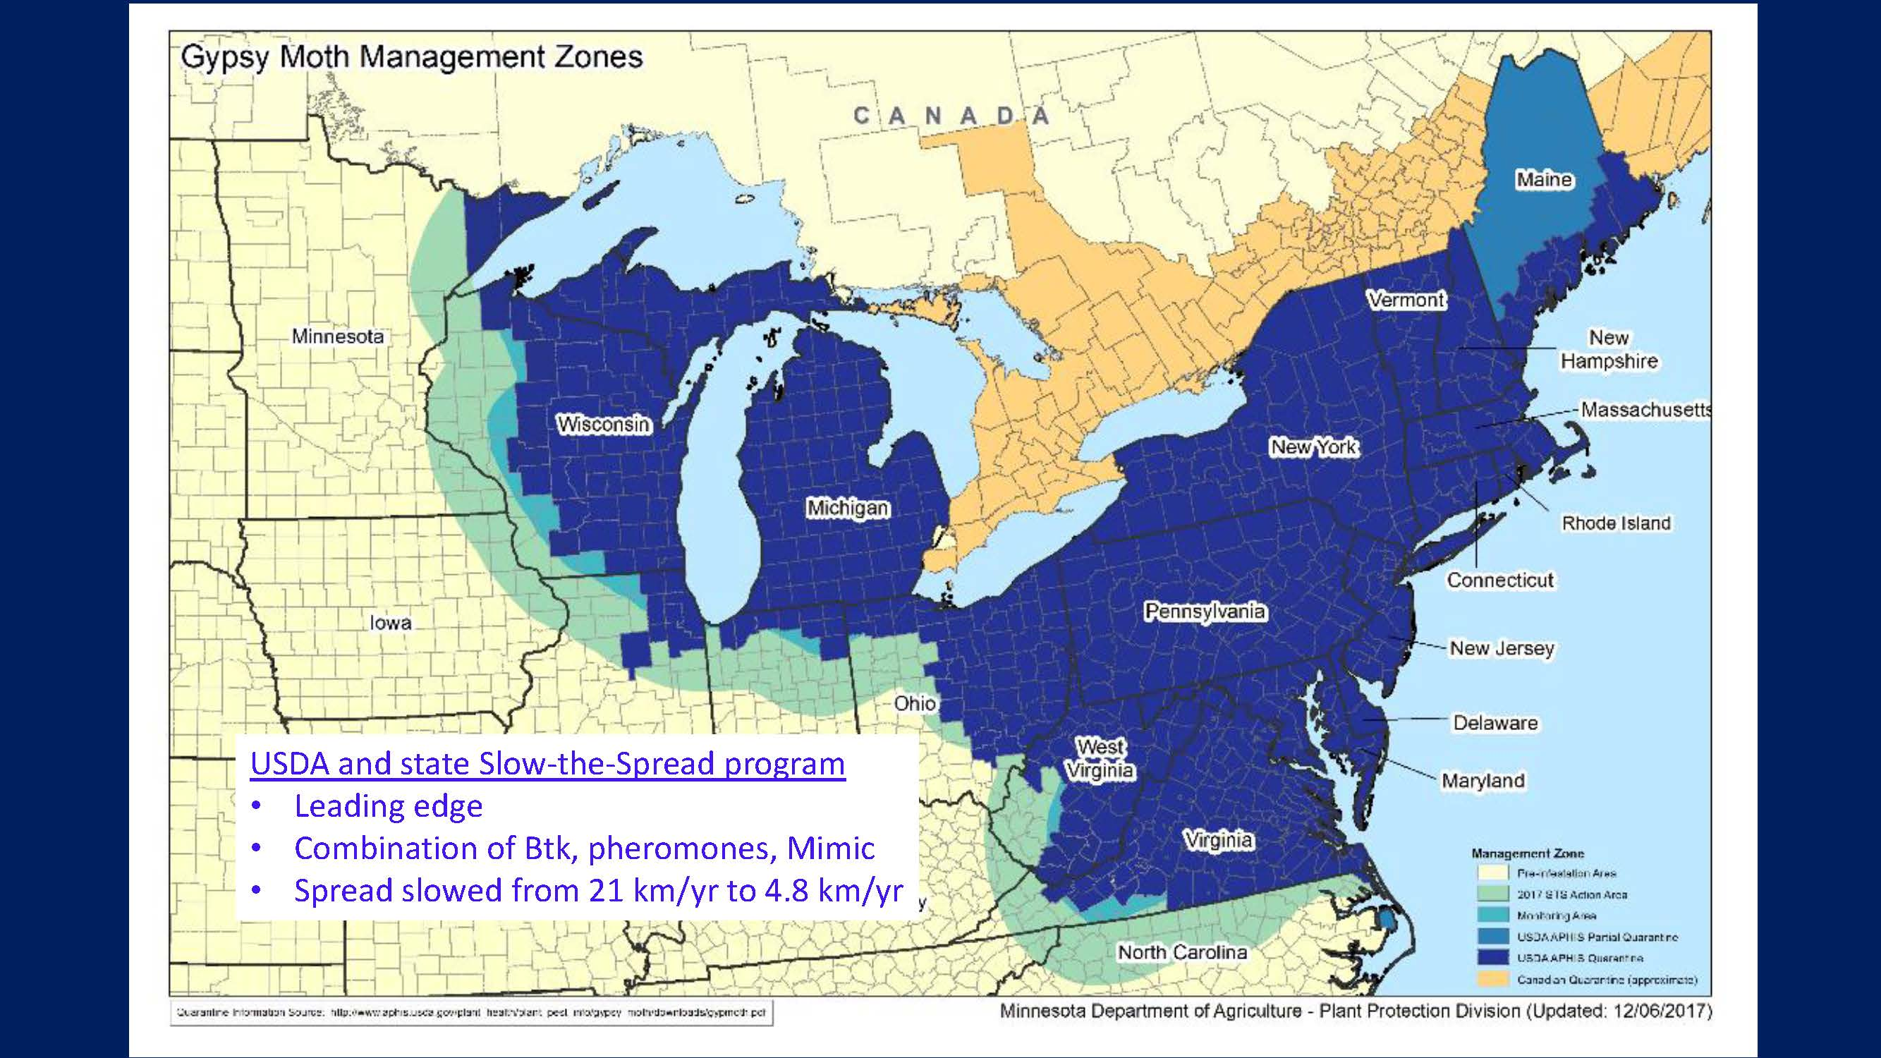
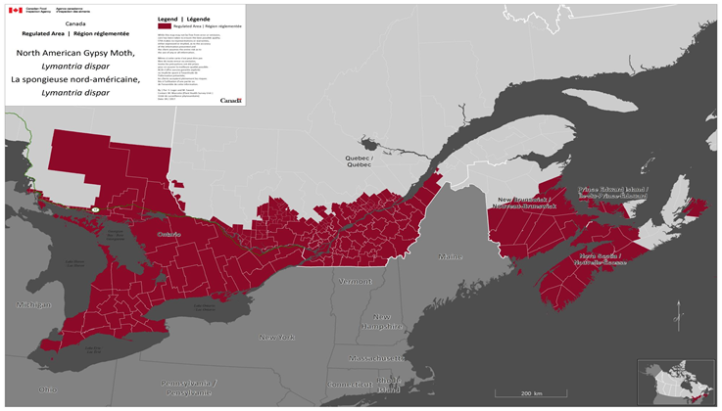
European Gypsy Moth
Population Range and Regulated Zones
10

Slide 11
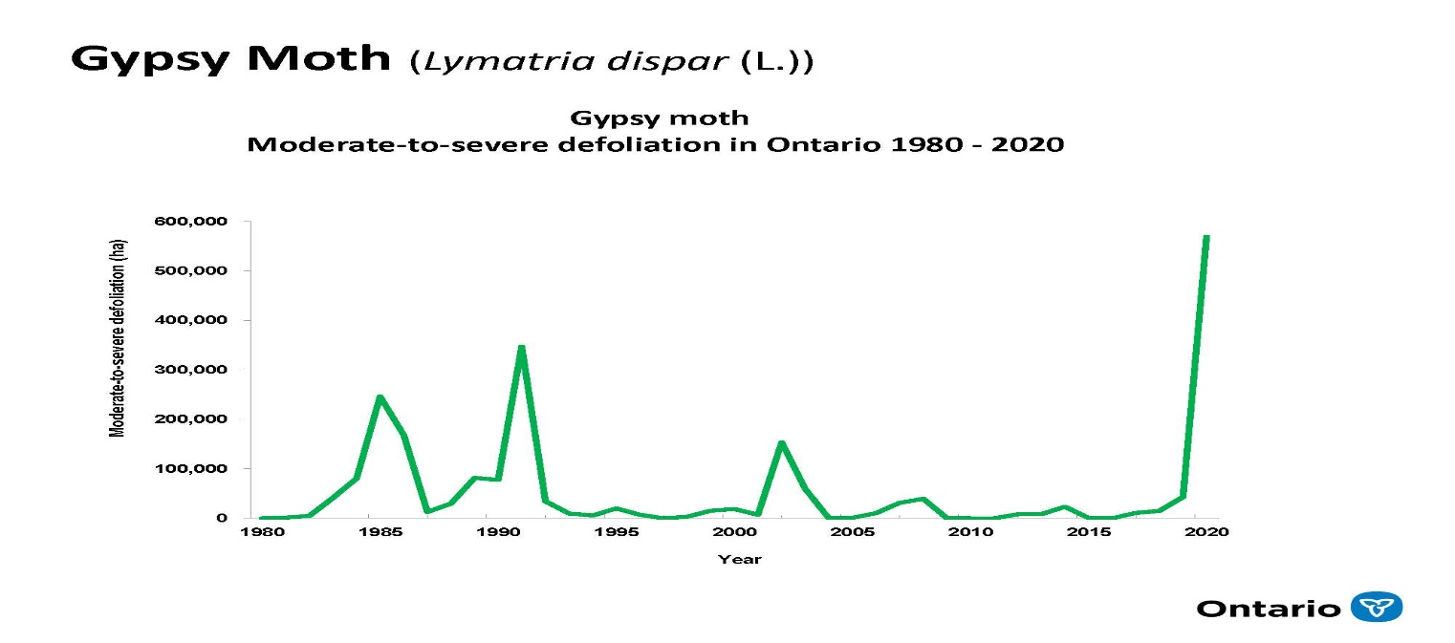
The Gypsy Moth in Ontario
First detected in Ontario on Wolfe Island in 1969
First outbreak commenced in 1981 near Kaladar in eastern Ontario and by 1985 had spread throughout south eastern Ontario
MNR implemented an aerial spray control program
By 1996 gypsy moth larvae noted south of a line from North Bay to Sault Ste. Marie
Outbreak peaks in this area in 1985, 1991, 2002 with moderate to severe defoliation in Mississauga and Etobicoke in 2005, 2018

Slide 12
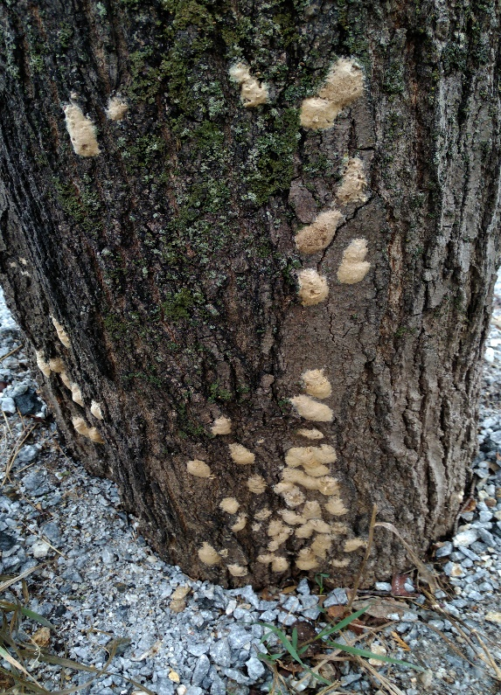
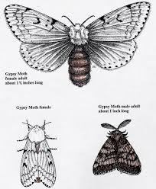
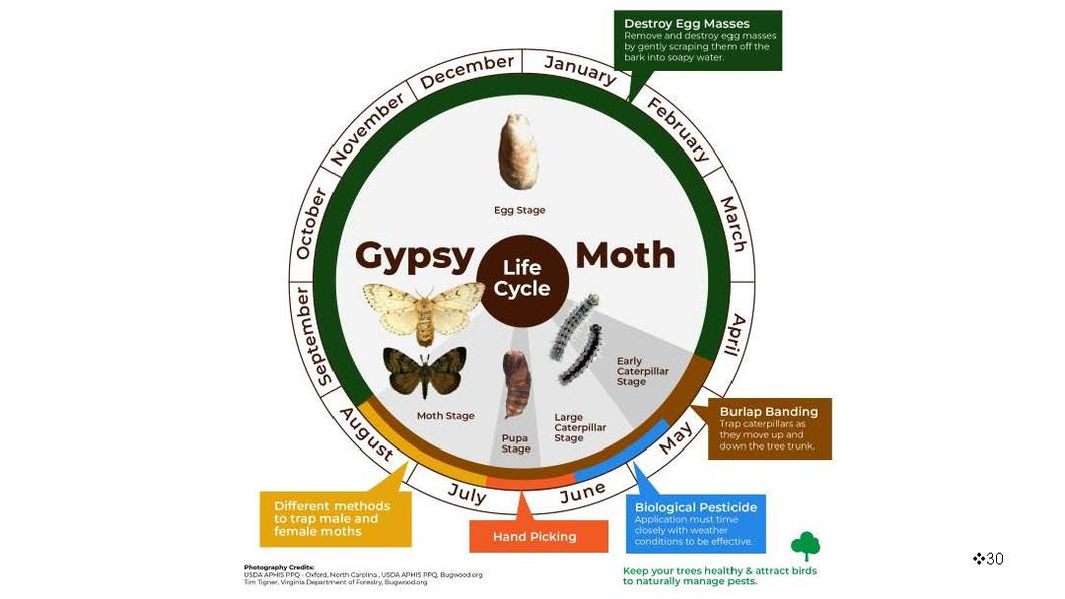
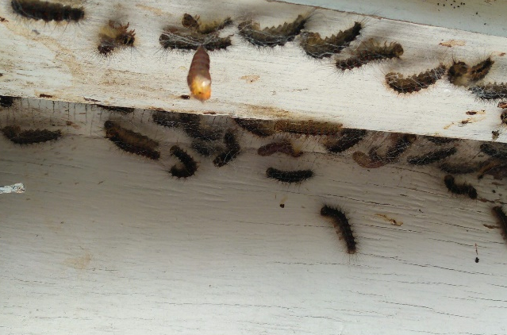
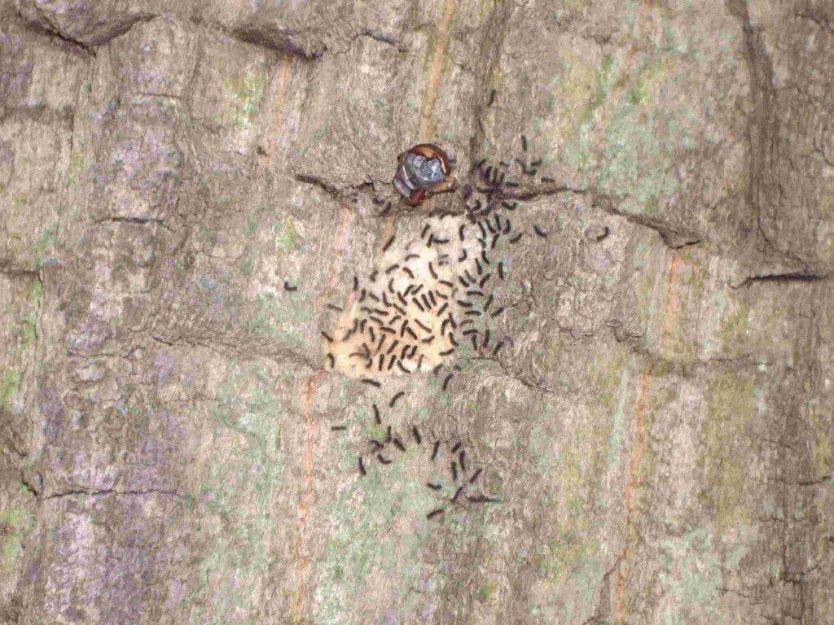
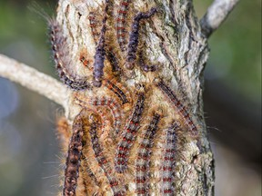
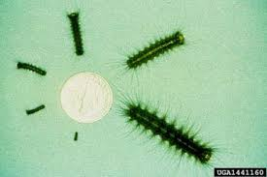
Annual Life Cycle

Slide 13
Gypsy moth 2020
Gypsy moth outbreak occurred in eastern Ontario
But the population had been building before then, and southwestern and central Ontario had suffered beginning in 2018
Kemptville Winter Woodlot Conference Webinar - February 3, 2021

Slide 14
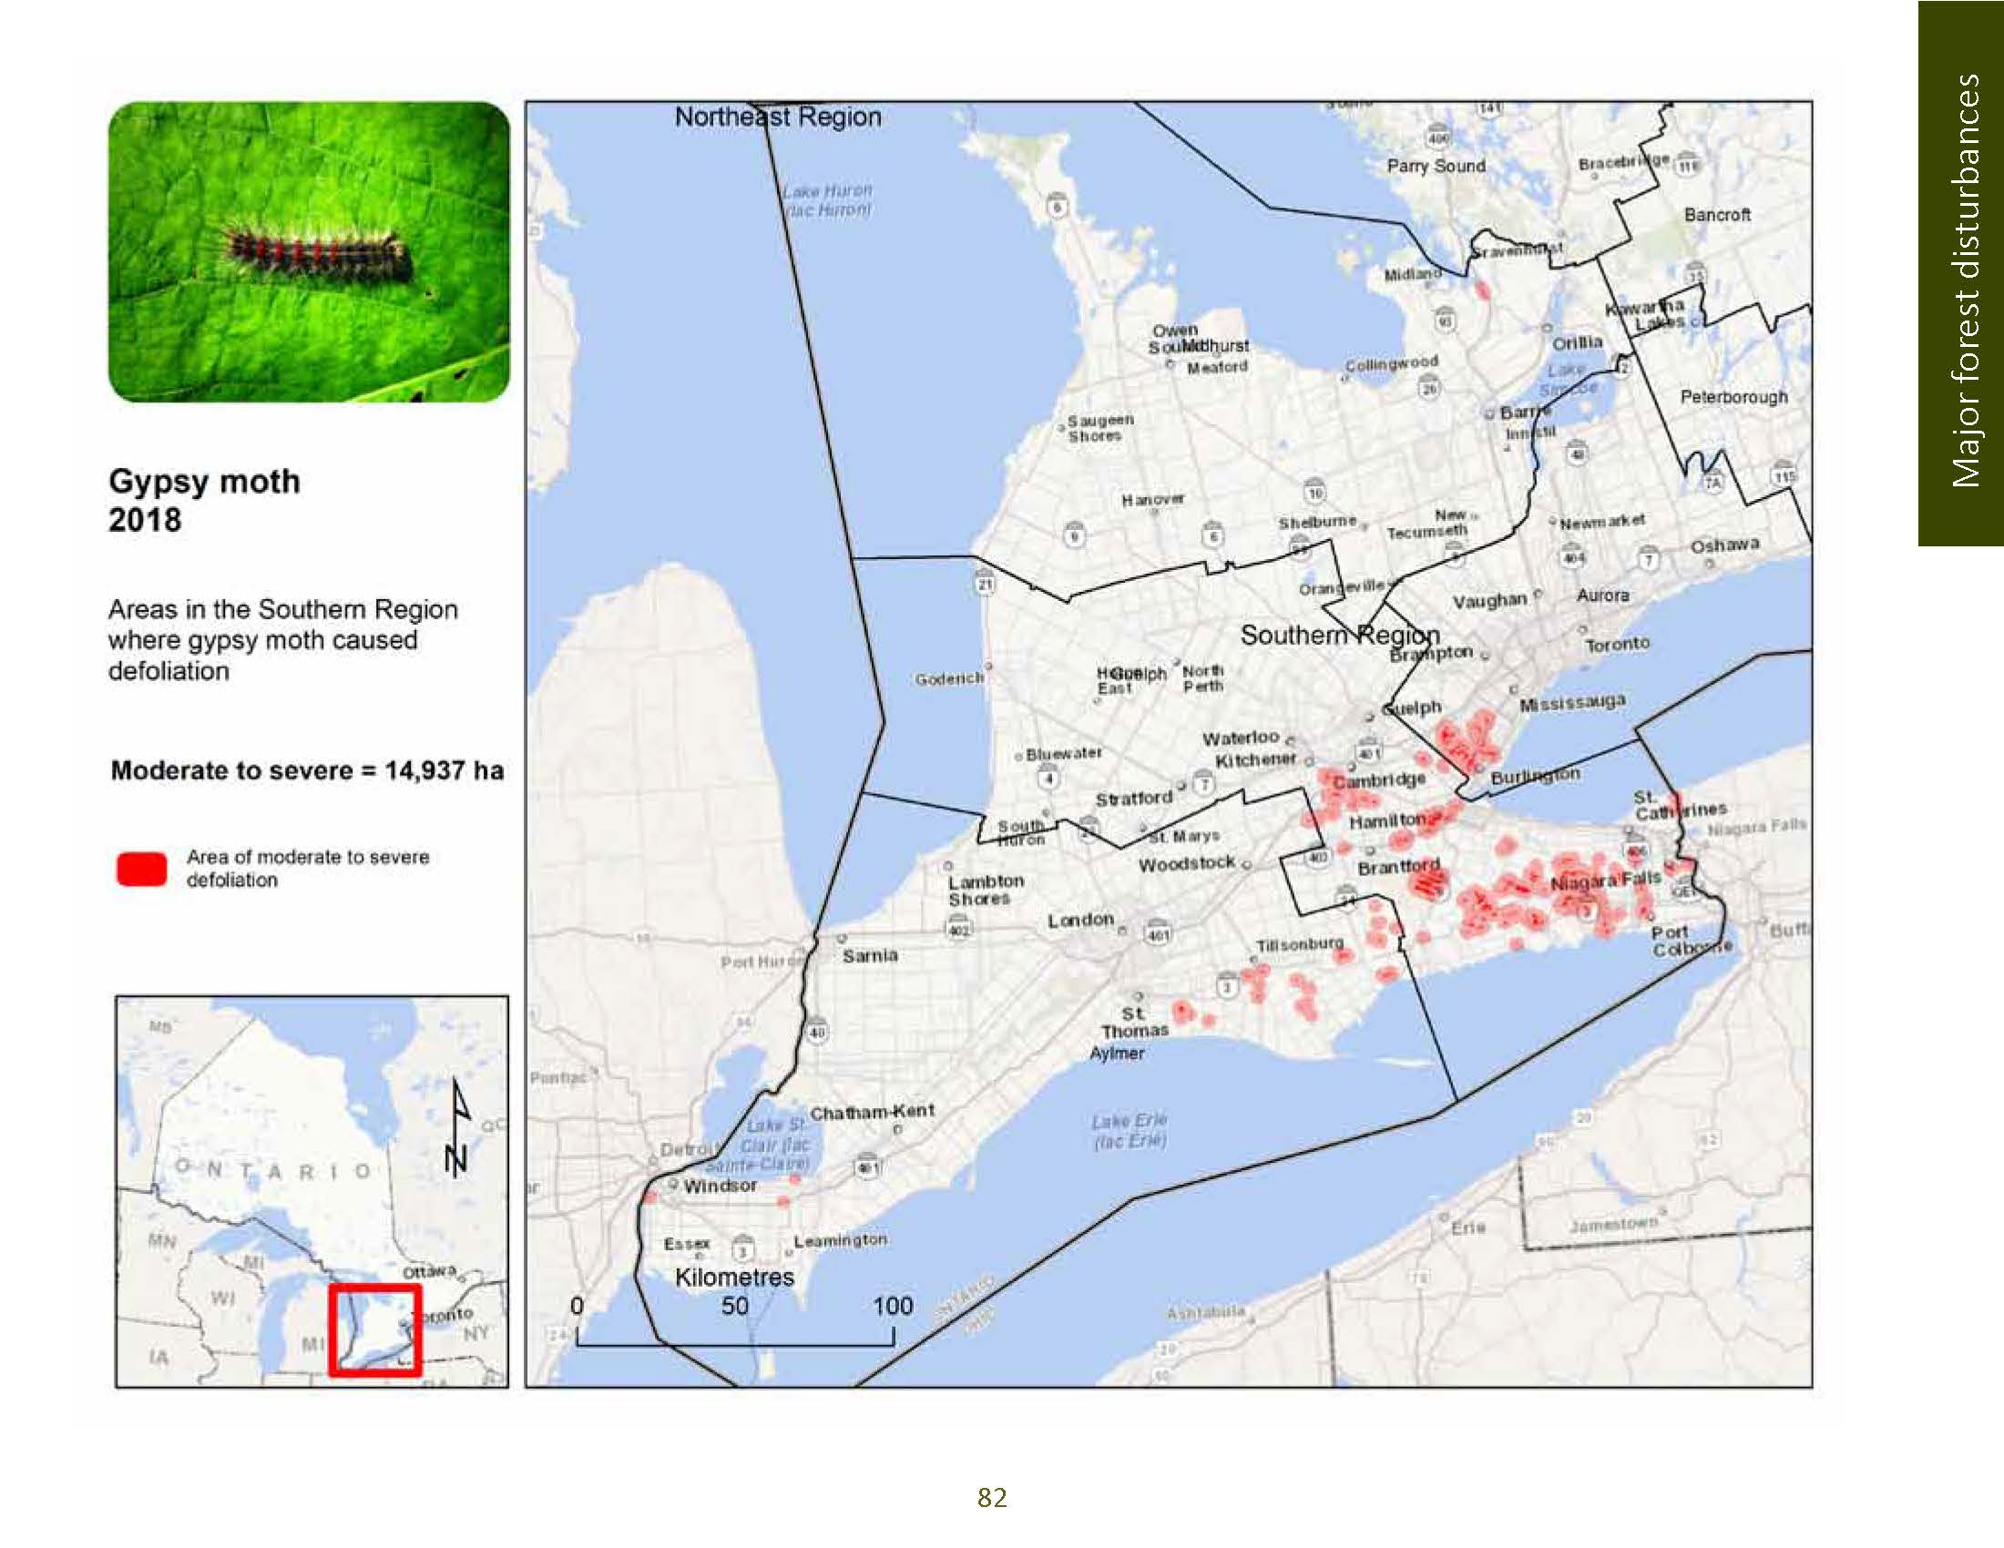
MNRF Survey results 2018
14
14

Slide 15
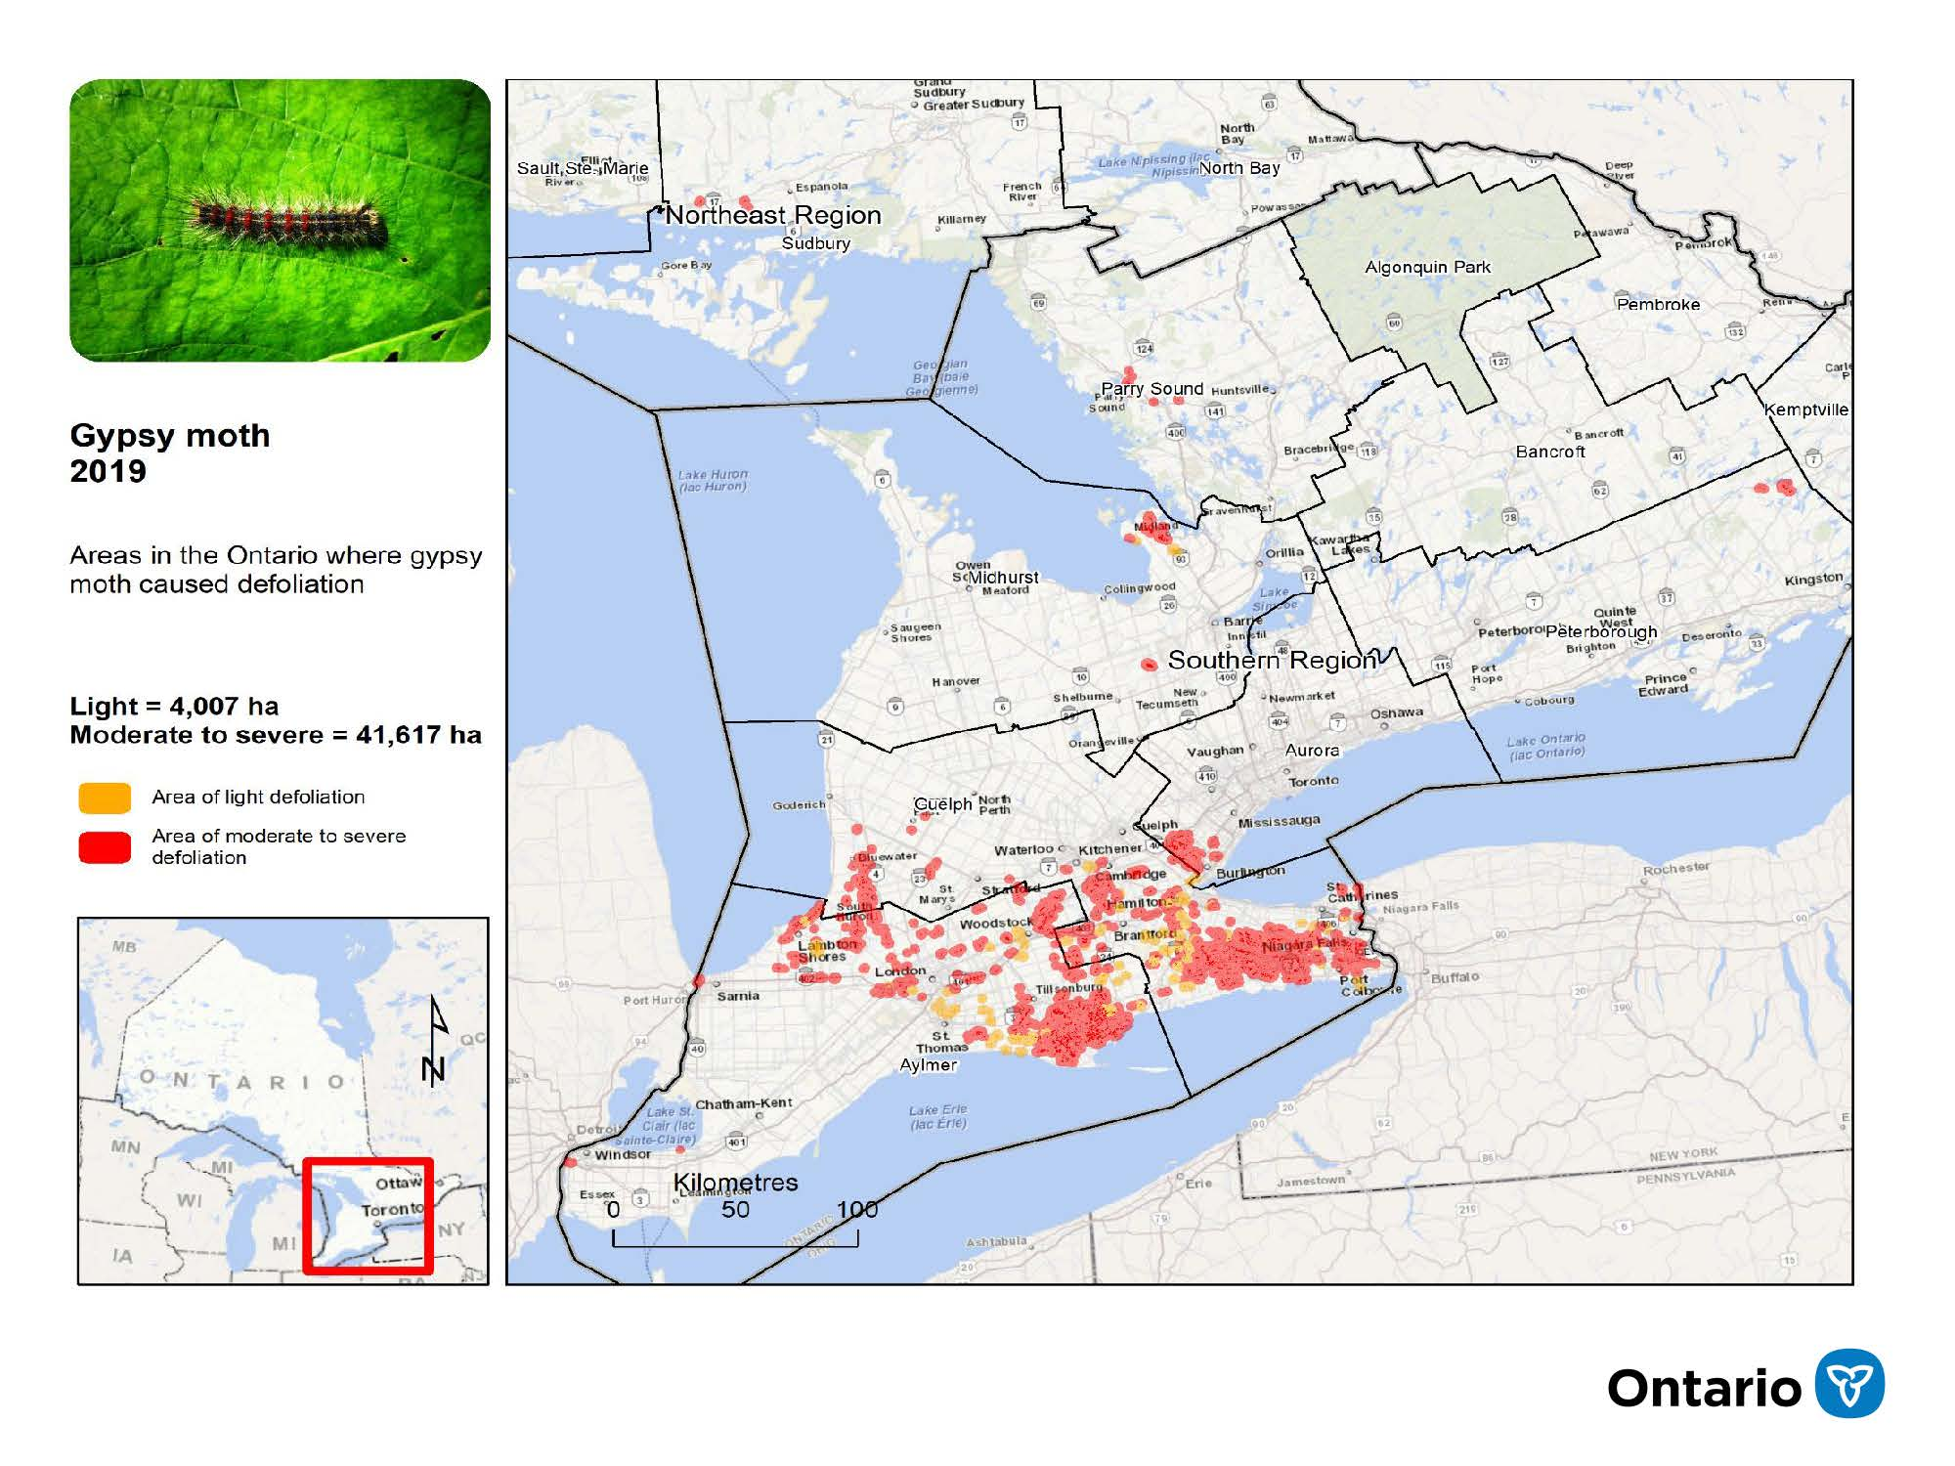
MNRF Survey results 2019

Slide 16
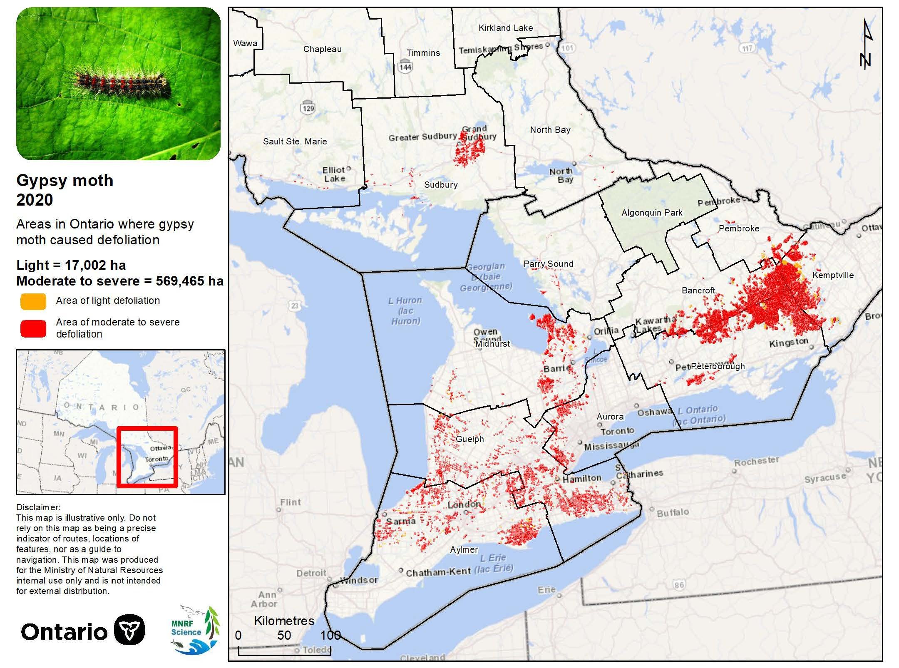
MNRF Survey results 2020
16
16

Slide 17
What makes Gypsy Moth defoliation so bad?
Size and impact of the population (each egg mass may contain 100 to 300 eggs)
  Each larva can consume 1m² of foliage (do the math!)
Defoliates many different species (in order of preference)
  Hardwoods include oaks, basswood, cherry, fruit trees, poplars, white birch, elms, willow, sugar maple, beech, and even ironwood
  Conifers include white pine, white and blue spruce, balsam fir, hemlock, larch
Kemptville Winter Woodlot Conference Webinar - February 3, 2021

Slide 18
What makes Gypsy Moth defoliation so bad?
Is a “late season” defoliator, meaning it does not finish feeding until early to mid-July
  Hardwoods may re-foliate if environmental conditions are favourable, but this coincides with the summer heat and drought, and uses valuable starch reserves
  Conifers can not re-foliate, and may die
Few natural predators
Nuisance and human health issues
Kemptville Winter Woodlot Conference Webinar - February 3, 2021

Slide 19
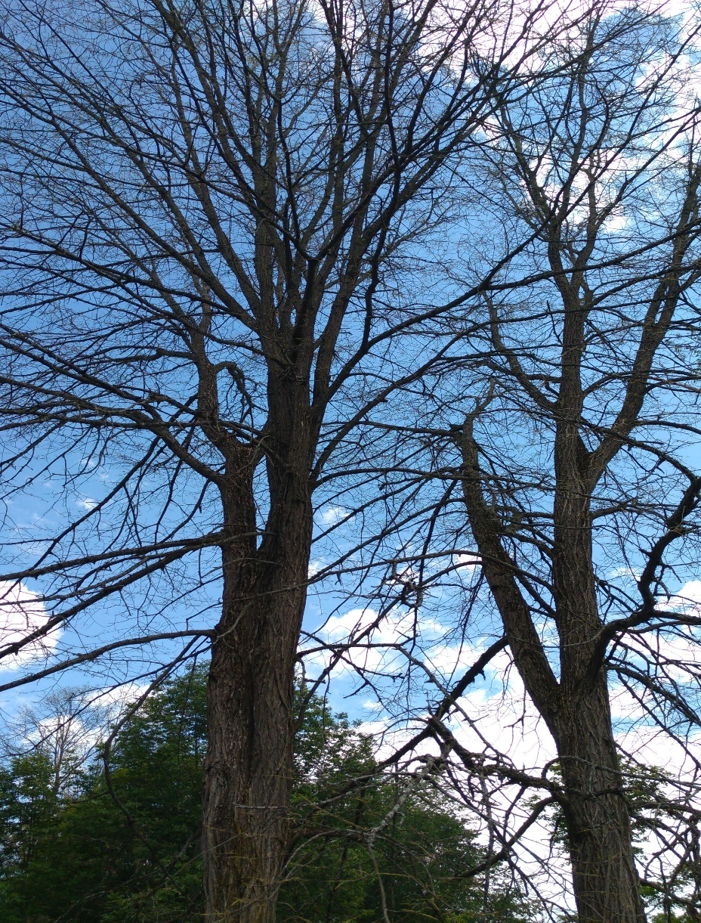
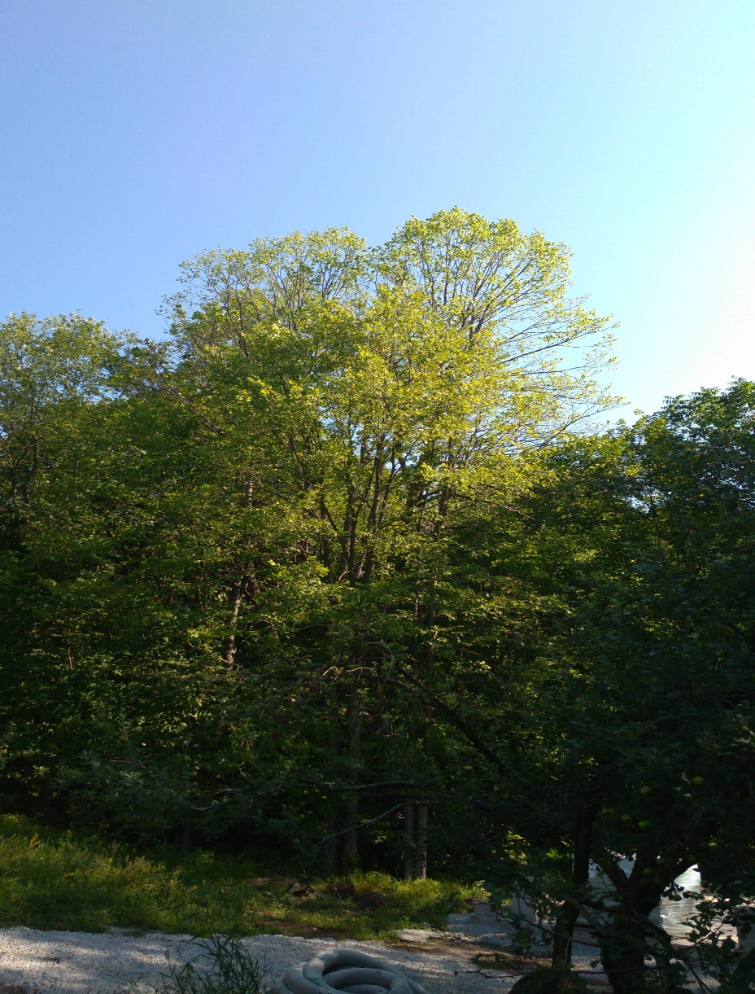
Defoliation / Re-foliation examples
Basswood – end of June
Mid-July
19

Slide 20
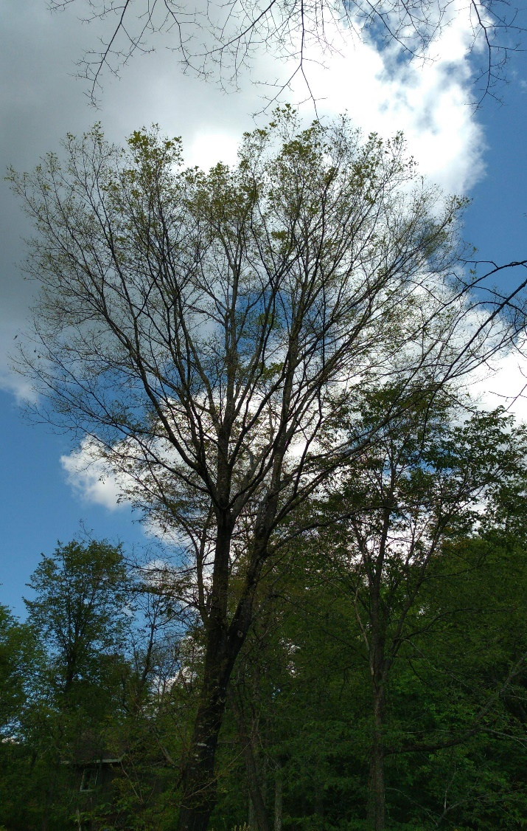
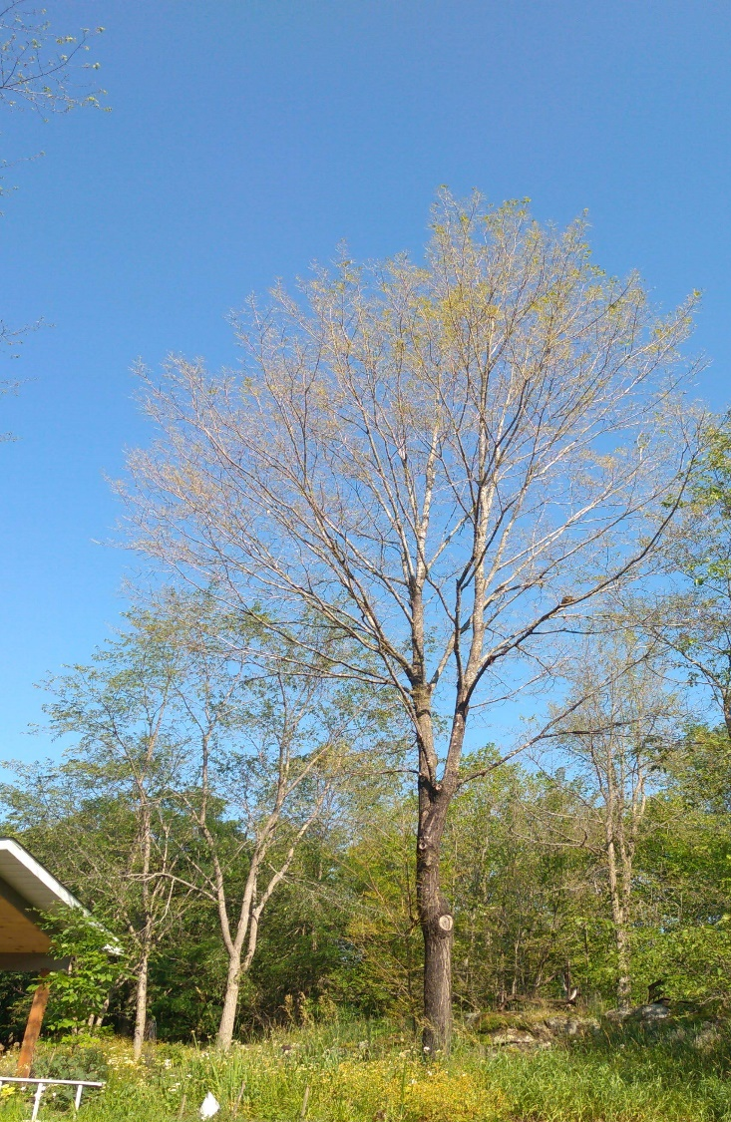
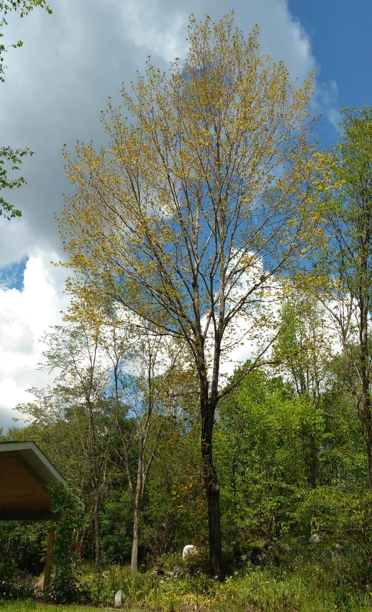
Defoliation / Re-foliation examples
Sugar Maple – end of June
Mid-July
End of August
20

Slide 21
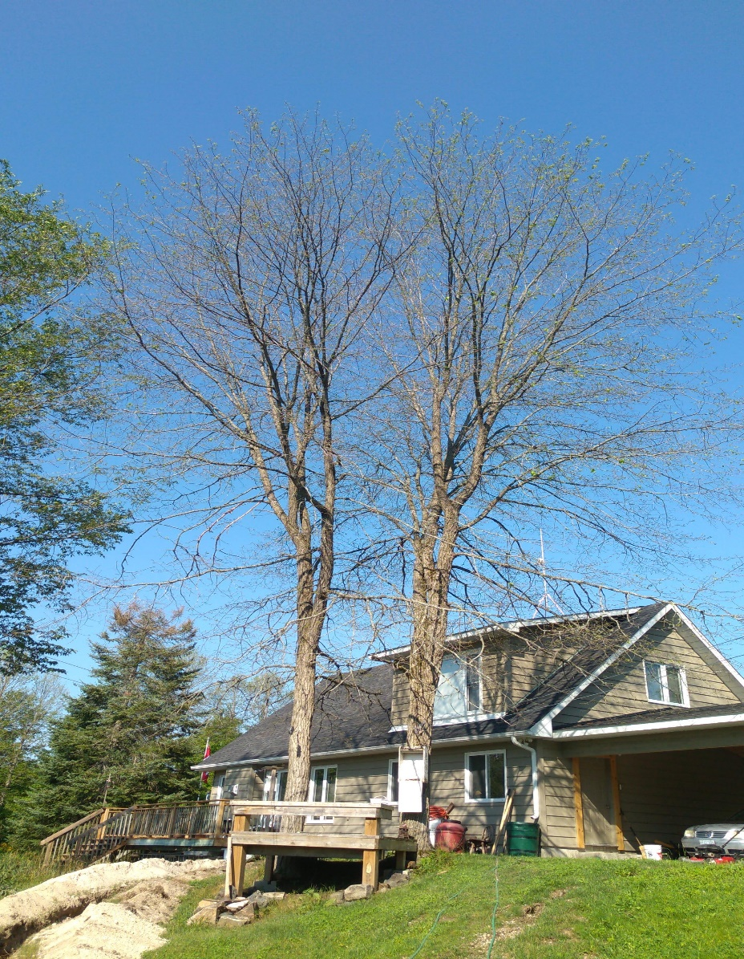
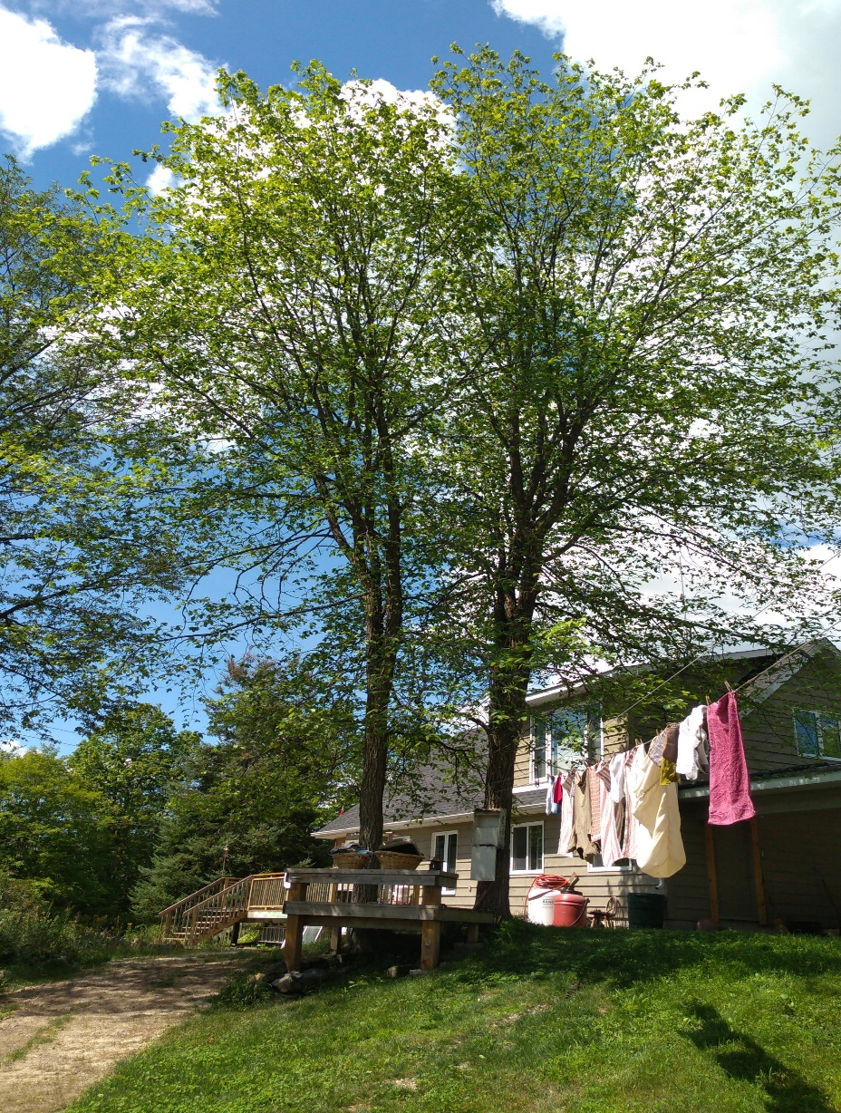
Defoliation / Re-foliation examples
Rock Elm – early July
End of August
21

Slide 22
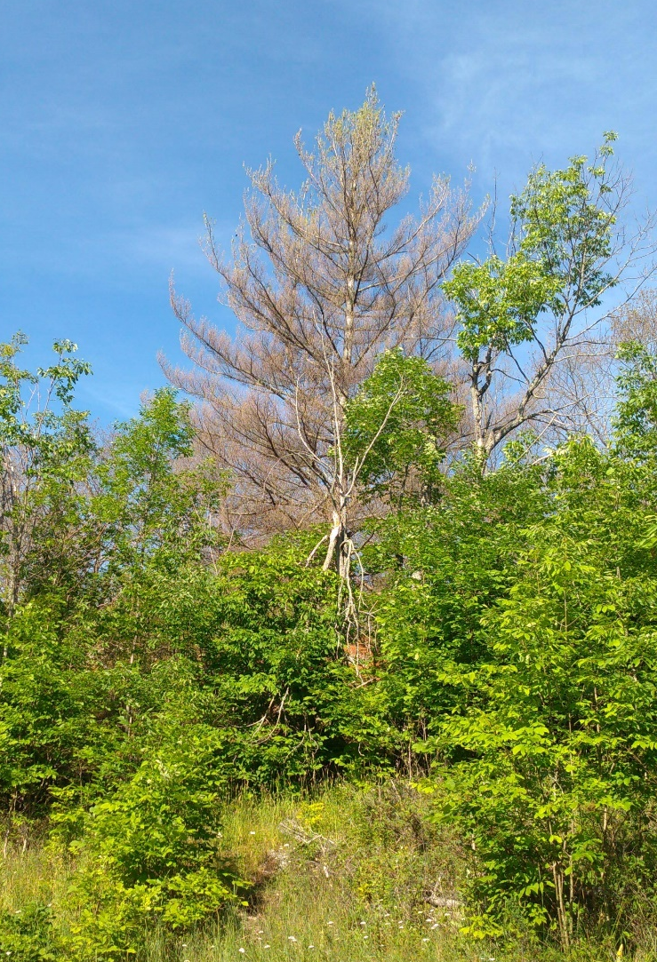
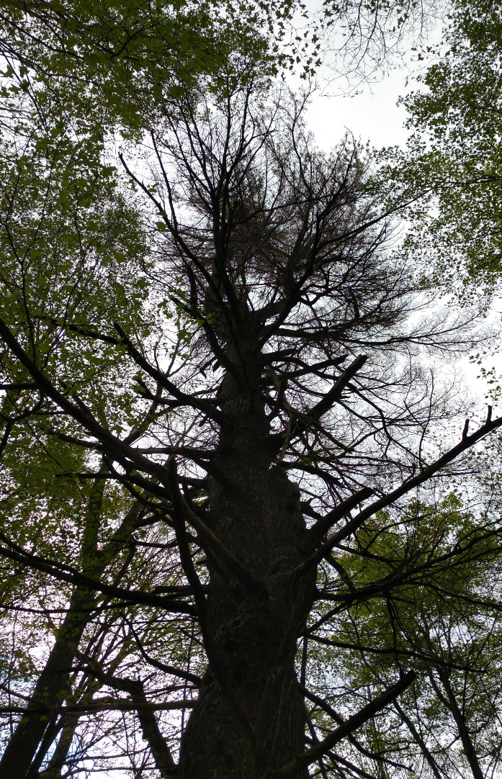
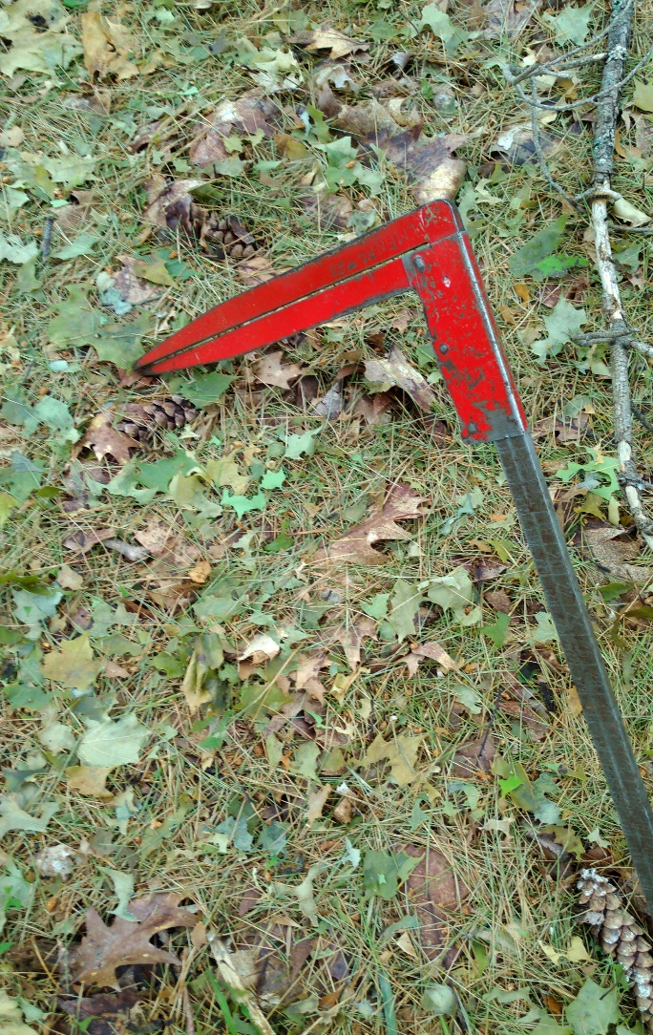
Defoliation / Re-foliation examples
White Pine – two year and older needles consumed
22

Slide 23
Forecast for 2021
It is difficult to predict what will happen in 2021, as there are many variables
  Egg mass counts are high, and egg mass size is large, but ….
  Natural control factors are building, including the fungus (Entomaphaga maimaga), and the Nucleo-polyhedrosis virus (NPV)
    Most effective with cool, wet temperatures in the spring
  Parasites (wasps) and other predators (mammals, rodents, birds) may also impact population development
  Human intervention likely to have little impact on overall population dynamics – focus on protecting individual trees, or smaller areas – aesthetics, health benefits
Kemptville Winter Woodlot Conference Webinar - February 3, 2021

Slide 24
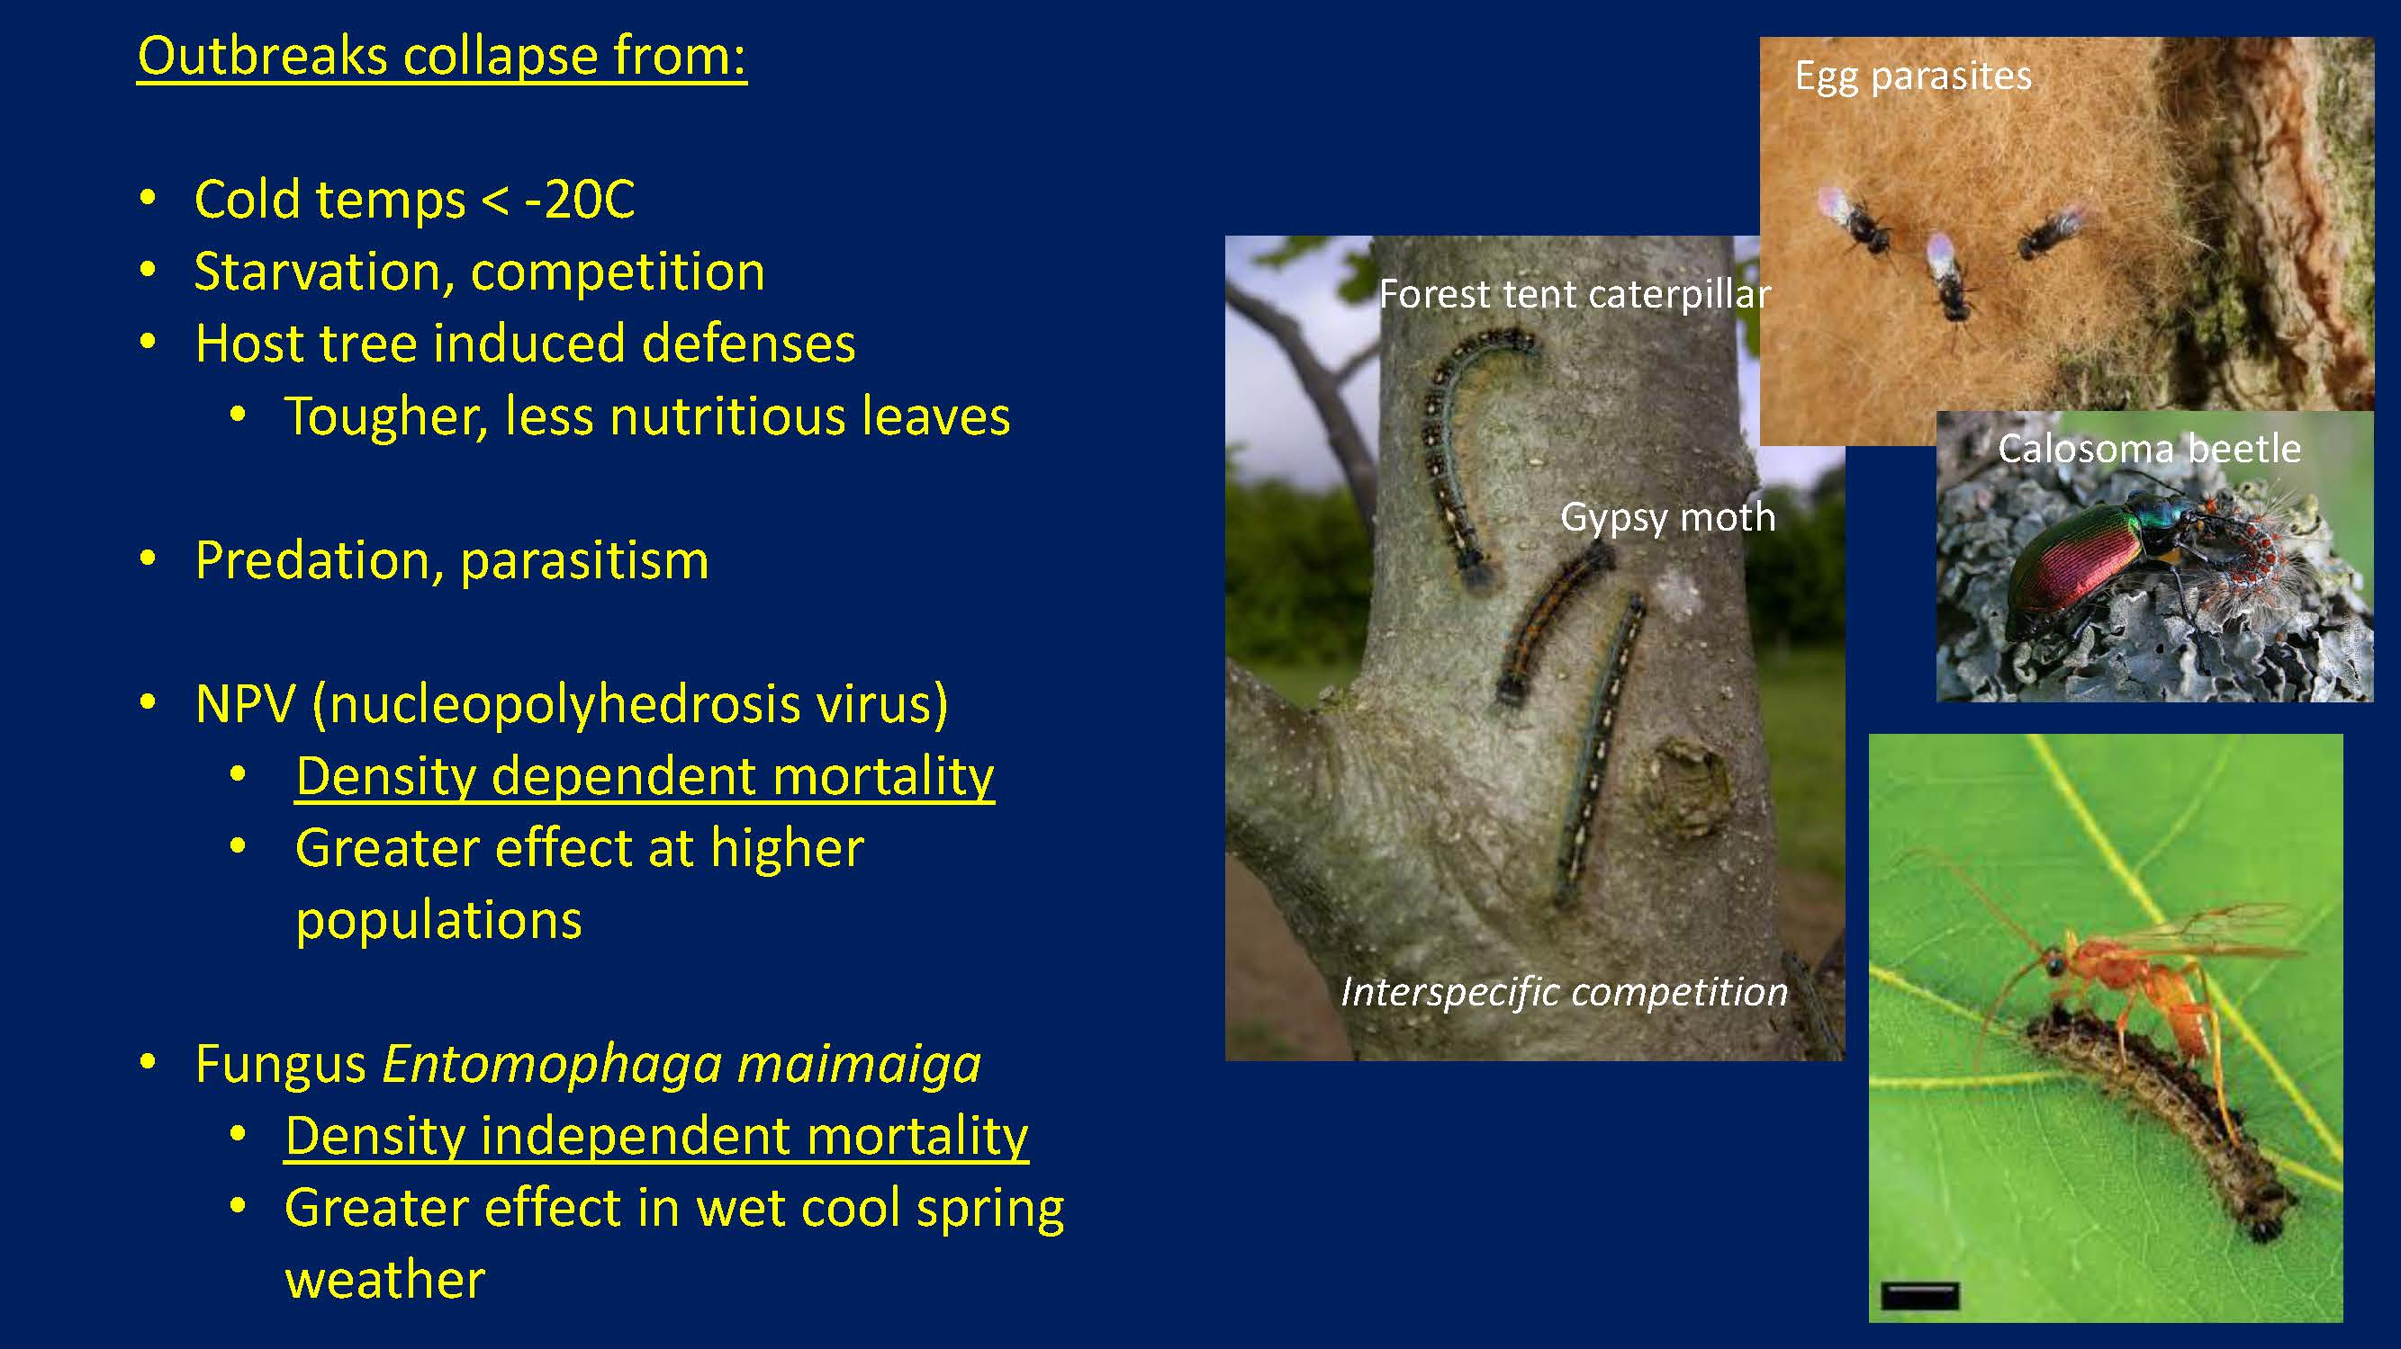
Braconid Parasitic wasp

Slide 25
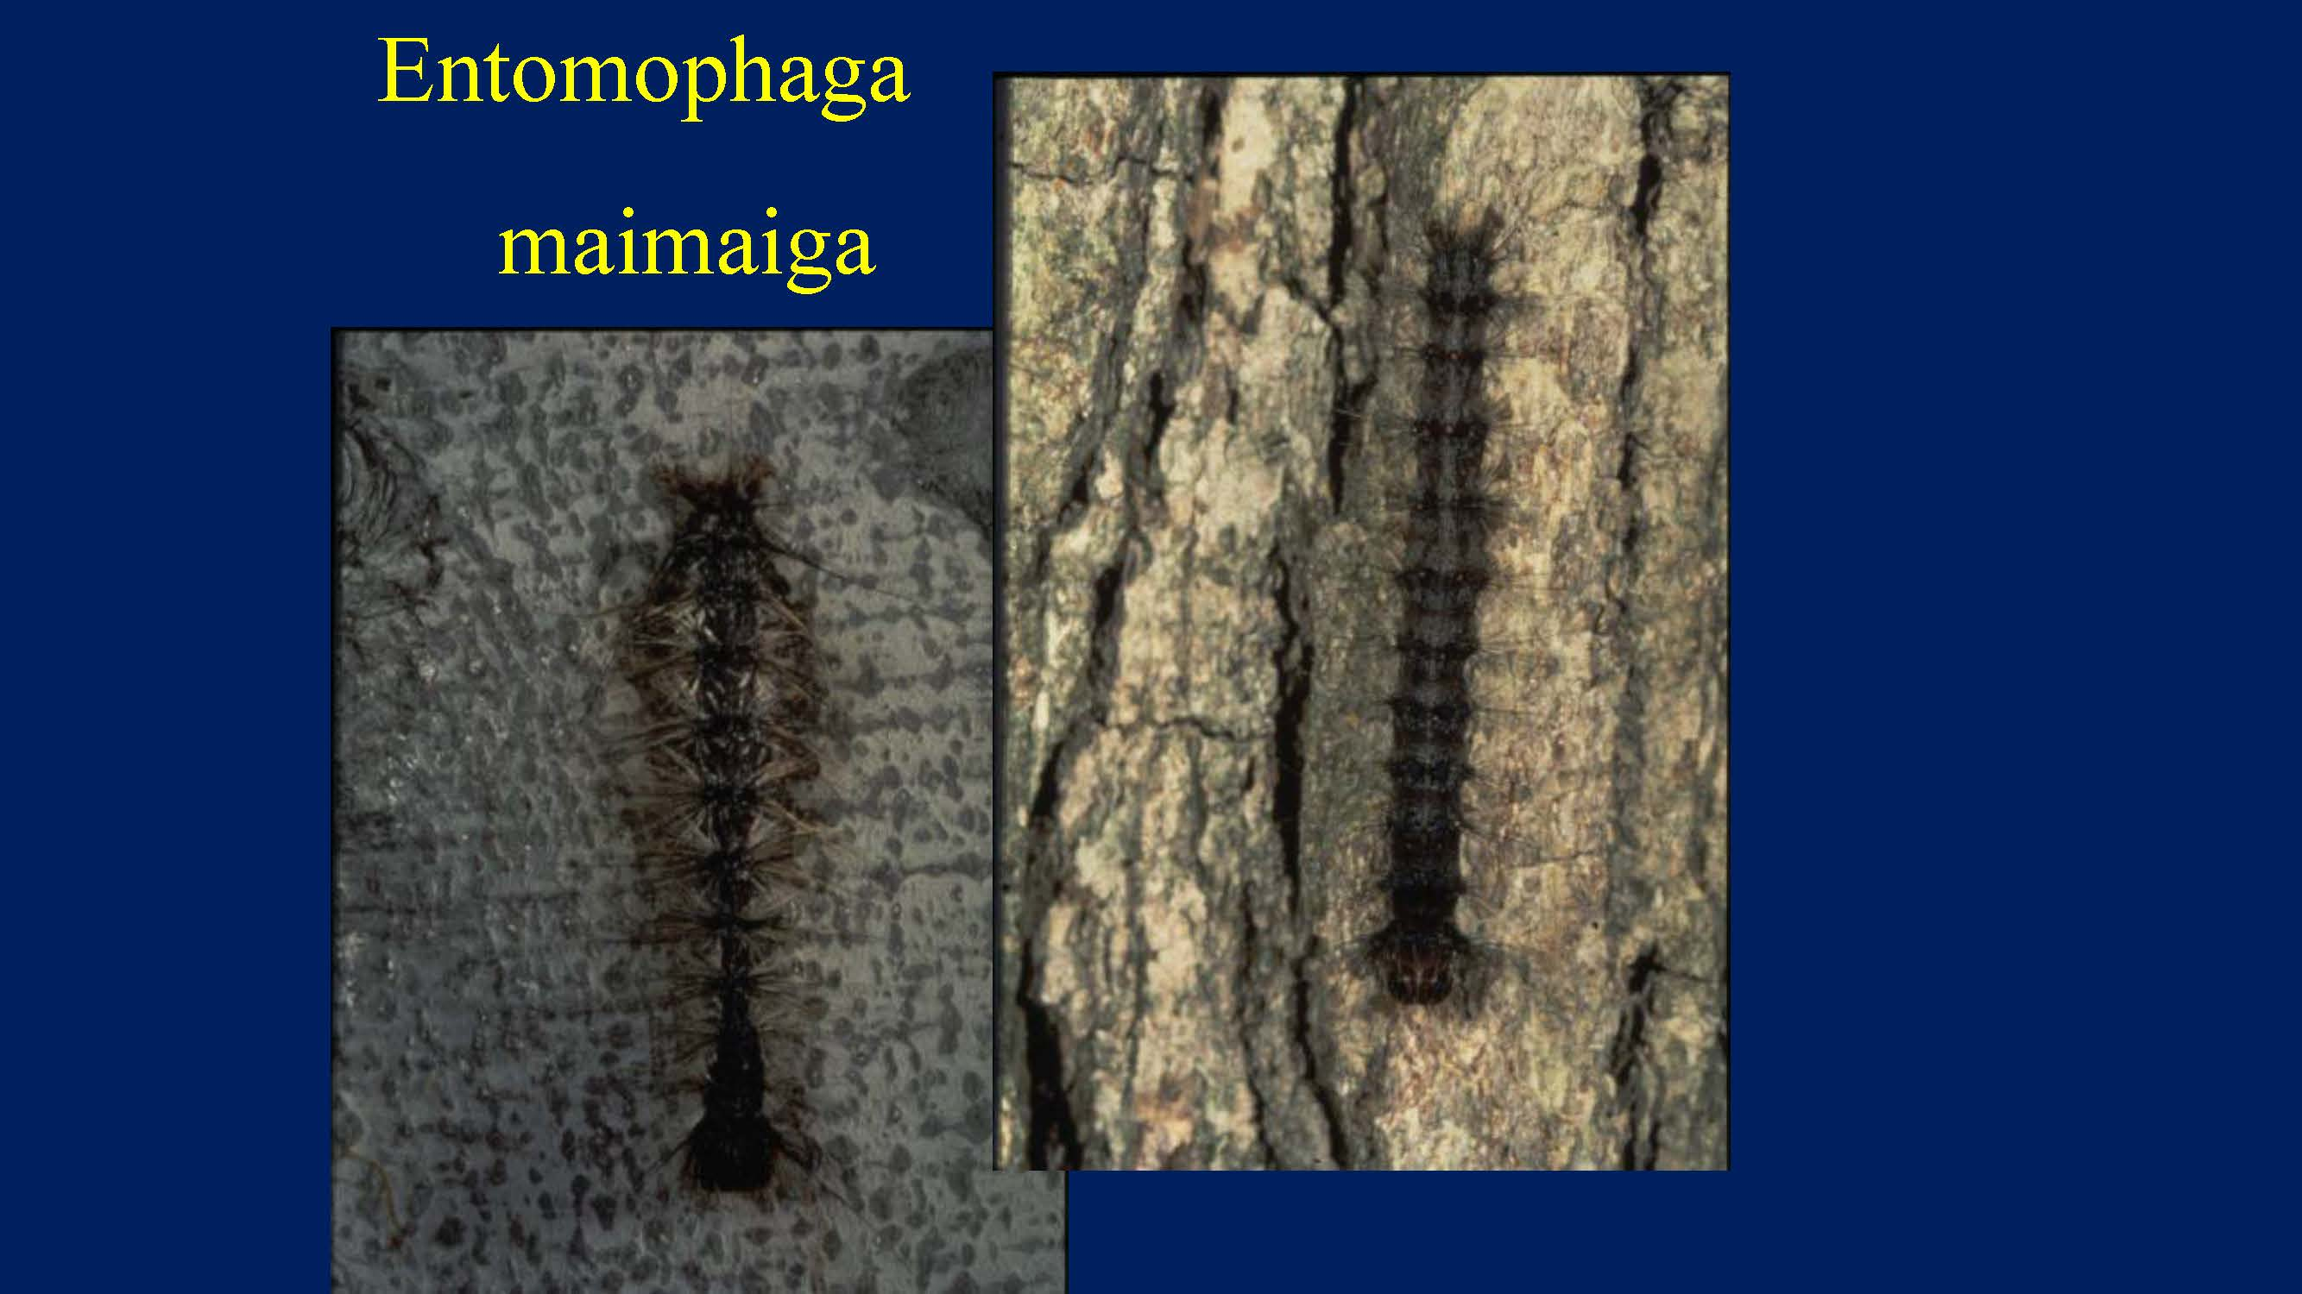
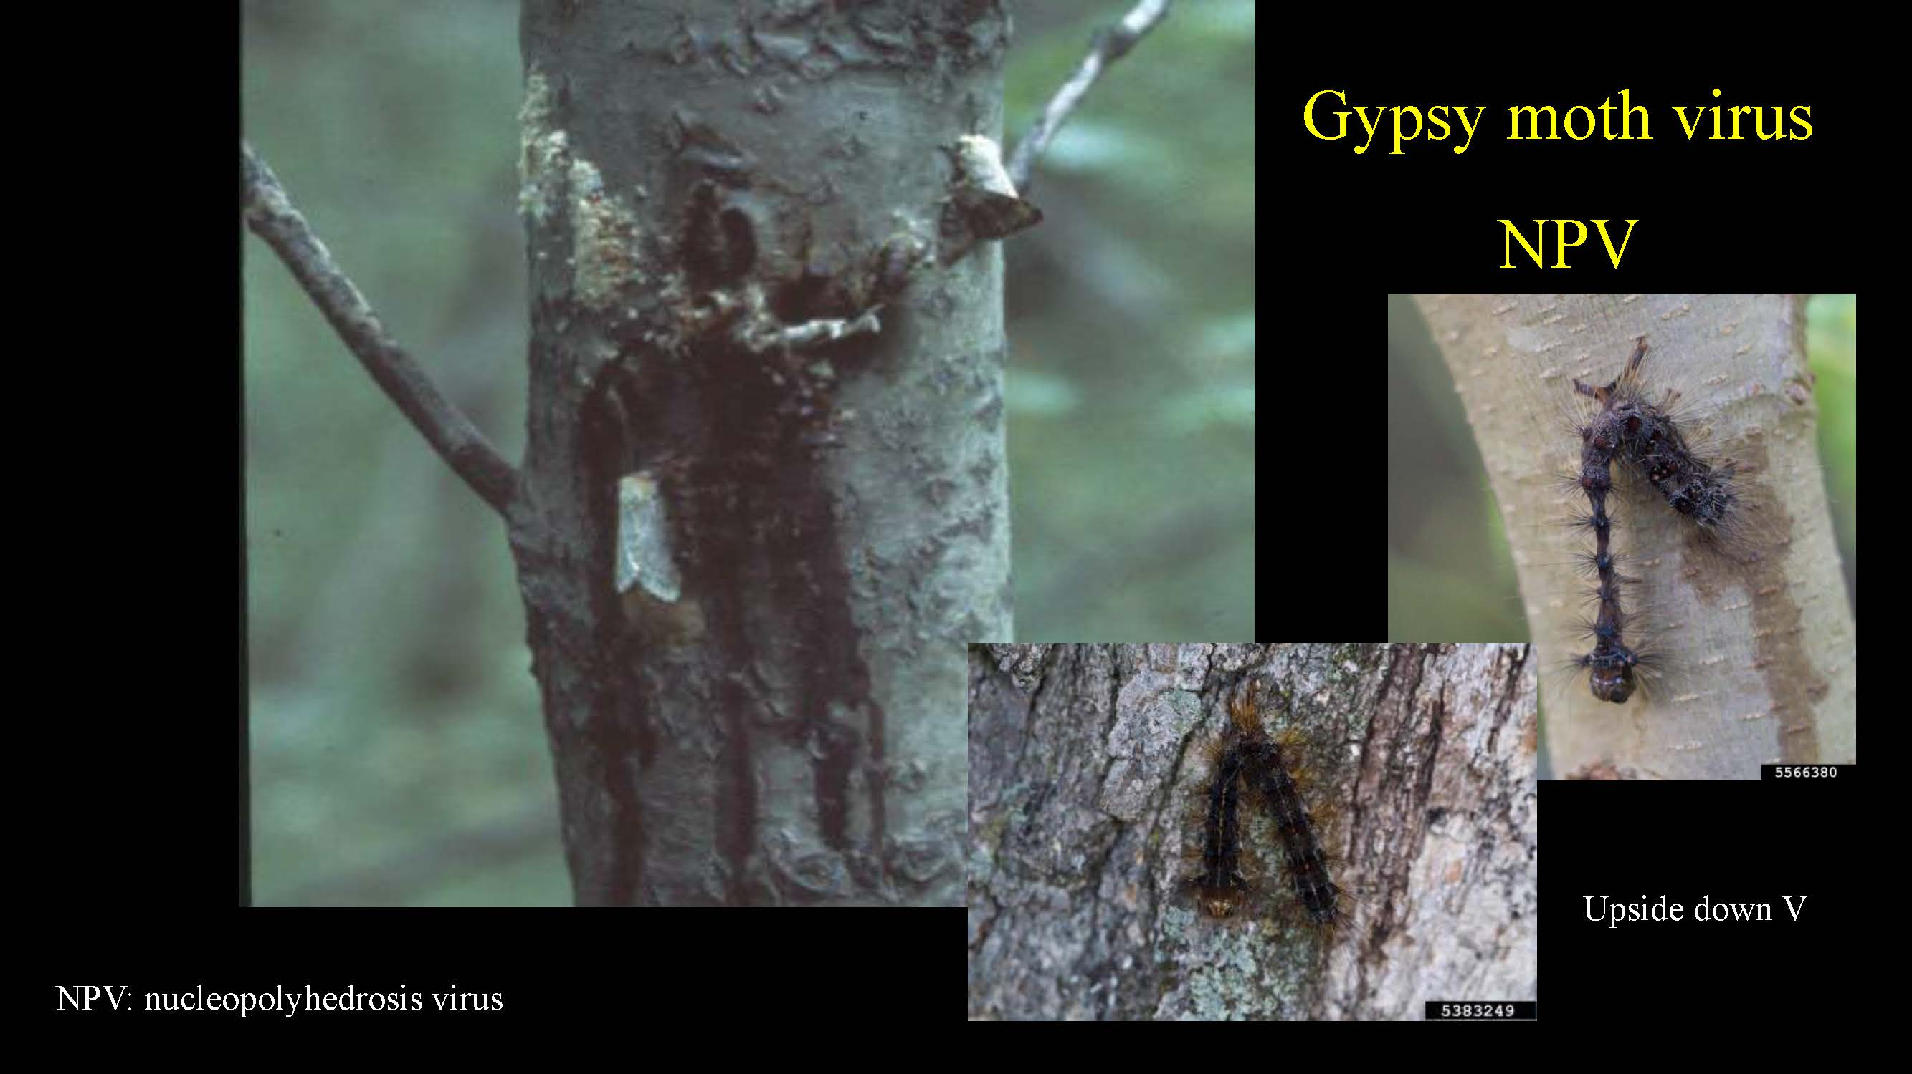

Slide 26
Planning for 2021
Step 1: Do your own risk assessment
  Egg mass counts
  Consider Forest / tree health impacts
  Value / costs
  Impacts on your management objectives
  Scale (tree level vs forest level protection)
Step 2: Consider management options and tactics
Step 3: Plan and implement
  Can you do it alone, or do you need help?
Kemptville Winter Woodlot Conference Webinar - February 3, 2021

Slide 27
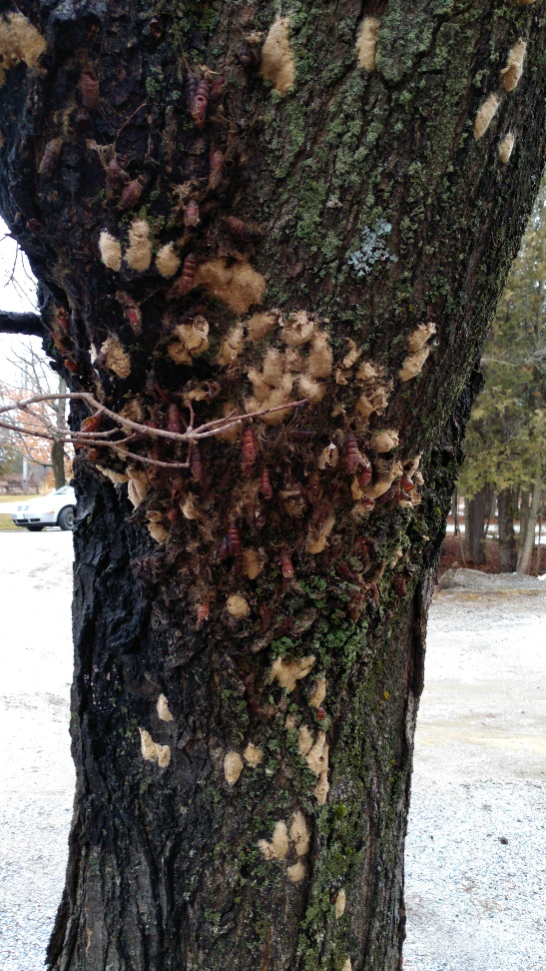
Egg Mass Counts Can Provide a Defoliation Forecast
Egg Mass per Hectare | Defoliation Forecast
0 | Nil
1 to 1235 | Light (1 to 40%)
1236 to 6175 | Moderate (41 to 75%)
6176+ | Severe (>75%)
In terms of individual susceptible trees, 5 to 8 egg masses per tree could result in 40% + defoliation

Slide 28
Management Options
Do nothing
  Wait for the population to collapse from natural factors
Take local, small scale actions
  Intervene at all GM life stages
  Trap, remove, destroy accessible larvae and pupae as they develop
  Protect special trees (ie close to the house, unique species, other tree health issues, etc)
  Water your trees well during and following defoliation to reduce overall stress
  Collect and destroy eggs
Kemptville Winter Woodlot Conference Webinar - February 3, 2021

Slide 29
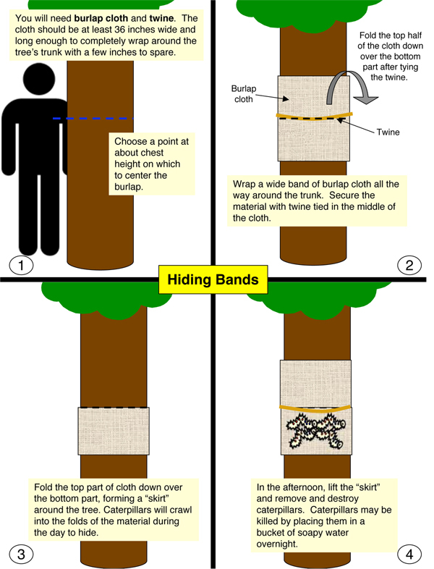



Slide 30
Management Options
Treat with pesticides, such as BTK, Sevin, or TreeAzin
  Small scale – you can purchase BTK at local hardware stores, and use a small back-pack sprayer. Height of control is limited.
  Large scale – use commercial services to spray with boom trucks from the ground, aerial application with helicopters or fixed wing aircraft, or direct injection of systemic pesticide
Kemptville Winter Woodlot Conference Webinar - February 3, 2021

Slide 31




Slide 32
If you are thinking of an aerial spray ….
Best suited to larger blocks of high-value forests
Logistically challenging
Highly regulated by Ministry of Environment, Conservation and Parks
Coordinate activities with neighbours to increase economy of scale
Work directly with a qualified applicator
Timing of spray is critical (calm winds, high humidity, no precipitation, proper life stage of caterpillar, etc)
May require multiple applications, especially if there is a staggered or delayed hatch
Kemptville Winter Woodlot Conference Webinar - February 3, 2021

Slide 33
Aerial spraying, 2021
Zimmer Air Services, Inc. is the main contractor
Need to be planning your operation – NOW!
  Use BTK (Foray 48B®), but it must be cultured ahead of time by the manufacturer
  Are currently working with over 6,000 landowners from across southern Ontario
  Deadline for application is March 1, but this may get tightened up
  Contact Dan Haupt: dhaupt@zimmerair.com
  See https://zimmerair.com/services/aerial-application-services/forest-pest-control/
Kemptville Winter Woodlot Conference Webinar - February 3, 2021

Slide 34
Final thoughts and actions ..text …
Monitor the hatch (timing)
Monitor the development of the larvae
Implement planned control actions
Pray for cool, wet weather
Monitor the short and long-term impacts on your trees / forests
Pay attention to other invasive insects and diseases, and report as necessary
Kemptville Winter Woodlot Conference Webinar - February 3, 2021

Slide 35
Acknowledgements and References
Thanks to:
  Vanessa Chaimbrone, MNRF, Peterborough
  Dr. Taylor Scarr, CFS, Sault Ste Marie
  Dan Haupt, Zimmer Air Services
  Invasive Species Centre, SSM
  Google
Useful References
https://www.ontario.ca/page/gypsy-moth#:~:text=The%20first%20detection%20of%20gypsy,infestation%20exists%20in%20New%20Liskeard
https://www.invasivespeciescentre.ca/invasive-species/meet-the-species/invasive-insects/gypsy-moth/
https://foca.on.ca/wp-content/uploads/2020/07/FOCA_webinar_Gypsy_Moth_July2020.mp4
Kemptville Winter Woodlot Conference Webinar - February 3, 2021

